Slide 1

2025-2026 School Growth Plan
School & Location: Uplands Elementary School, 4110 Thomas Street, Terrace, BC
Principal: Annette McAlpine
Issue Date: September 29, 2025
HIGH QUALITY INSTRUCTION
Theme & A Statement about Learning: ⇦Community: A strong community fosters learning by creating a space where diverse voices are heard, knowledge is shared freely, and growth is a collective journey—not an individual race
School Video link (optional): ⇦ Life at Uplands

Slide 2
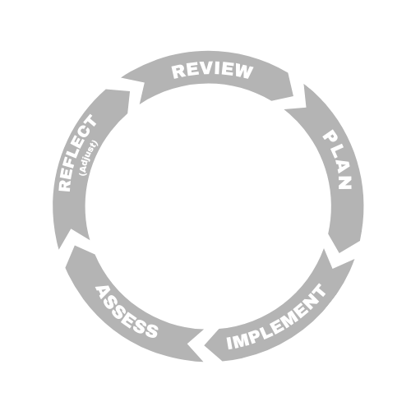



LITERACY
Uplands Elementary School, Terrace
Goal
At Uplands, we recognize, along with the First Peoples, that learning nurtures not only the self but also strengthens the community. We are committed to ensuring that all students from kindergarten to grade six develop proficiency in foundational literacy skills, guided by the understanding that learning takes patience and time. Our goal is to enhance student learning, engagement, and confidence—empowering students to communicate effectively in a variety of ways.
School Actions/Strategy
Literacy Actions
Create structured literacy blocks using the District Literacy Framework .
Support new teachers with the implementation of UFLI and the use of Acadience as a K to 6 screener.
Examine Acadience data with teams and establish SMART goals to develop a literacy plan for increased student outcomes.
Work with literacy support teachers to develop a system of support for all students in yellow and red areas of Acadience.
Emphasize literacy instruction across all subject areas.
Implement the use of Empower for Tier III intervention.
Provide more choice to enhance student engagement and creativity.
Examine data throughout the year and adjust goals and programme delivery as needed.
School Data & Evidence
Literacy Measures:
FSA Grade 4
School-Wide Write
Adadience Data
Student Self-Assessments
Individual Education Plans (IEPs) (as applicable)
Multi-Tiered System Support (MTSS)
Objectives
We use literacy data to drive and adjust instruction for all our learners.
We implement competency-based assessment and reporting.
We offer the opportunity for all students to demonstrate their learning in ways that are meaningful to them.
District Data & Evidence
FSA 4 (Reading/Writing)
Acadience Data
School-Wide Write
Kindergarten Screener

Slide 3

NUMERACY
NUMERACY
Uplands Elementary School, Terrace
Goal
We are committed to developing student proficiency in numeracy from Kindergarten through Grade 6. Our aim is to equip learners with the skills to analyze, solve, and communicate mathematical ideas effectively in real-world contexts.
Objectives
Increase teacher capacity through professional development.
Implement a school-wide strategy in coordination with the district-wide framework.
Implement data-driven, timely and targeted instructional interventions for students
School Actions/Strategy
Numeracy Actions
Collect and analyze data (e.g., standardized assessments, report card marks, classroom-based assessments).
Identify achievement gaps by grade level, class, and student subgroups.
Establish SMART goals focused on improving numeracy outcomes.
Promote balanced math instruction (fluency, conceptual understanding, and application).
Use assessment data to identify students needing additional support.
Increase teacher efficacy through professional development opportunities (e.g., Lunch and Learns).
Share successes and challenges across staff to build collective efficacy.
School Data & Evidence
Numerary Measures
Grade-Level District Numeracy Results
FSA (Grade 4)
Report Card Results
Anecdotal observations, ongoing classroom assessment, and conversations with teaching staff and learner support teams
District Data & Evidence
Grade 4 FSA
K to 12 Report Card Data
District Numeracy Assessment

Slide 4

INCLUSION
Uplands Elementary School, Terrace
Goal
We are committed to honouring, celebrating, and respecting culture, diversity, and inclusion to create a sense of belonging where every student feels welcomed and empowered to thrive. Equity and inclusion are essential foundations for learning, leadership, success, well-being, and personal fulfillment.
Objectives
Enhance the achievement of all learners with an emphasis on Indigenous learners, children and youth in care, and students with designations.
Celebrate and acknowledge the diverse cultures, languages, backgrounds in the school community through events, assemblies, and classroom activity.
School Actions/Strategy
Inclusion Actions
Attendance: Closely monitor and track student attendance in MyEd and implement early, proactive interventions, such as regular check-ins, culturally responsive outreach, and collaborative problem solving with students, families, Indigenous Support Workers, and Indigenous Education Coordinators (where applicable), to reduce chronic absenteeism and support student engagement.
Integrate diverse perspectives into the curriculum (literature, history, social studies, etc.) so students see themselves and others represented
Use culturally responsive teaching practices: adapt instruction to students’ backgrounds, experiences, and learning styles.
Bias-awareness & anti-bias education: teach students about fairness, justice, respect, and how to recognize stereotypes or bias.
School Data & Evidence
Inclusion Measures
Tracking Attendance
EdPlan Insight
Student Voice
FSA
Student Learning Survey
Report Cards
District Data & Evidence
Aboriginal How Are We Doing Report
Local Education Agreement (LEA)
Student Learning Survey (Grade 4)
FSA results
Student Voice

Slide 5

MENTAL HEALTH & WELL-BEING
Uplands Elementary School, Terrace
Goal
We are dedicated to a holistic and reflective approach to ensuring that students feel safe, experience a sense of belonging, and are supported in an environment where their mental health and well-being are prioritized. By strengthening mental health supports, building staff capacity, and promoting a school-wide culture of care and connection, we aim to ensure every student feels valued, understood, and equipped to thrive.
Objectives
Embed mental health and wellness strategies in classroom instruction to help students develop emotional awareness, self-regulation, coping, and resilience skills.
School to parent communication offering resources to help families support their children's mental health..
School Actions/Strategy
Mental Health & Well-Being Actions
As a school, establish SMART goals to determine which mental health and wellness toolkit to use for a common-language framework that includes ready-to-use mini-lessons, check-in prompts, and reflection activities aligned with course competencies like self-awareness, empathy, and responsible decision-making (i.e., Open Parachute, EASE, etc.)
Encourage the use of Uplands TEA Healthy Habits throughout the school and in all classrooms.
Involve students in planning and participating in monthly assemblies that focus on the Uplands CARES code of conduct and the Uplands Healthy Habits.
Include a dedicated "Wellness Corner" in the monthly school newsletter featuring practical mental health tips, links to local support services, and highlights from ongoing school well-being initiatives.
School Data & Evidence
Mental Health & Well Being Measures
School results to the relevant Development Index.
Student Learning Survey
Anecdotal teacher data
District Data & Evidence
Student Learning Survey (Grade 4)
EDI (Early Years)

