Slide 1

2025-2026 School Growth Plan
School & Location: Thornhill Primary School
Principal: Sandy Kenmuir
Issue Date: September 2, 2025
HIGH QUALITY INSTRUCTION
Theme & A Statement about Learning:
Our mission is to inspire a love of learning through hands-on experiences, where students take pride in their growth, enjoy the journey, and build a respectful, supportive community.

Slide 2
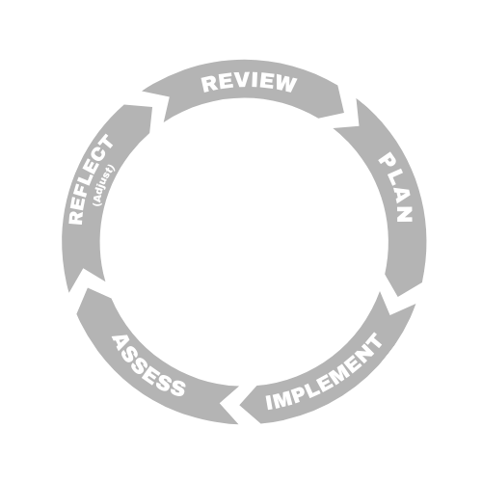



LITERACY
School Name: Thornhill Primary School
Goal:
We want all our students to be reading at grade level by the end of grade 3. We want all our students to be confident in their written and oral communication.
Objectives
We use data to inform teaching.
We deliver a purposeful, dynamic, and multi-modal literacy program to all students.
We use rich literature, that represents our student body, to teach and model concepts.
School Data & Evidence
Literacy Measures here:
Acadience Data
Progress Monitoring
Term Assessments
School-Wide Write
Learning Updates
School Actions/Strategy
Literacy Actions here:
An MTSS approach to literacy instruction and support will be used by classroom teachers and the school team.
The 90-minute literacy framework that was developed by the district team will be discussed, collaborated on, and implemented.
Explicit teaching of reading (UFLI) and comprehension (Braidy) will be used.
Progress Monitoring using Acadience will be used to inform next steps and targeted support.
A plan for explicitly teaching writing skills will be developed by the school team.
District Data & Evidence
-Acadience Data
- School Wide Write
- Kindergarten Screener

Slide 3


NUMERACY
NUMERACY
School Name: Thornhill Primary School
Goal
We are dedicated to helping our students develop foundational number sense and basic operational skills so that they will be ready for more complex mathematical thinking in the years to come.
School Actions/Strategy
Numeracy Actions here:
Teachers will work together during several school-wide collaboration times to:
Develop a big-picture progression of what K-3 Numeracy looks like across the grades. What is most important?
Outline the progression of concepts and assessment for each grade level.
Share ideas around unit planning, lesson structure, and resources.
Objectives
We focus on learning through doing. Students need engaging, hands-on activities to explore, practice and master concepts.
We use frequent and meaningful assessment to drive instruction.
School Data & Evidence
Numerary Measures here:
Formative Assessment observations by staff
Learning Updates
District Numeracy Assessment Results
District Data & Evidence
District Numeracy Data
Learning Updates

Slide 4

INCLUSION
School Name: Thornhill Primary School
Goal
We strive to have a school culture in which all students and families feel represented, seen, and valued.
Objectives
We will reduce the number of students with excessive absences.
We will enhance the achievement of all learners with a focus on students who are Indigenous or have designations.
We will continue our anti-racism education to build awareness, challenge biases, and dismantle systemic racism within the school environment.
School Actions/Strategy
Inclusion Actions here:
We will monitor and track student attendance closely. Necessary follow-up will occur (as applicable) from the teacher, school office, IESW, or in consultation with the education coordinator.
We will embed the Ts’msyen Smalgyax language in daily activities and have it visible around the school.
We will host events that bring families into the school as partners in their children’s learning.
We will endeavour to have elders and role models from the Kitselas Nation share their knowledge in classrooms and at school events.
We will provide staff training so that our designated students are working on their own programs within their classroom environments at all possible times. Our classrooms will be rich with visuals to aid these students in their learning.
School Data & Evidence
Inclusion Measures here:
Attendance (MyEd)
EdPlan Insight
Numeracy Assessments
Literacy Assessments
Learning Updates
District Data & Evidence
Aboriginal How Are We Doing Report
Local Education Agreement

Slide 5

MENTAL HEALTH & WELL-BEING
School Name: Thornhill Primary School
Goal
To create a supportive environment for social-emotional learning so that students can learn to manage their emotions, develop resiliency, acquire healthy coping skills, and build positive relationships.
School Actions/Strategy
Mental Health & Well-Being Actions here:
We will use a multi-tiered system of supports across all grades with in-class counselling lessons that will promote self-understanding and the use of strategies to increase mental wellness.
2. The tier one support will establish the use of a
common language throughout the school as different
programs will be taught in each term (The Zones of
Regulation, Open Parachute, EASE,
and Mind Up).
3. Language and strategies will be posted in each
classroom and throughout the school.
Objectives
A common language and strategies will be embedded within all aspects of school.
2. Parents will receive information on
skills and strategies that are being
taught in the monthly newsletter so
that they can support learning at home.
Create peer support networks and mental health clubs.
School Data & Evidence
Mental Health & Well Being Measures here:
Student self-reflection and responses
Office referrals
District Data & Evidence
-Early Development Inventory

