Slide 1

2025-2026 School Growth Plan
School & Location: Thornhill Elementary School
Principal: Surinder Dhaliwal
Vice Principal: Kate Doane
Issue Date: Sept. 22nd, 2025
Theme & A Statement about Learning: At Thornhill Elementary School, we are committed to fostering growth in every student. We strive to nurture strong literacy and numeracy skills, support the well-being of all learners, and honour Indigenous knowledge and perspectives. Our goal is to continue growing as a community where every child feels empowered, respected, and inspired to reach their full potential.
School Video link: https://newrelationshiptrust.ca/building-future-skills-through-stem/

Slide 2
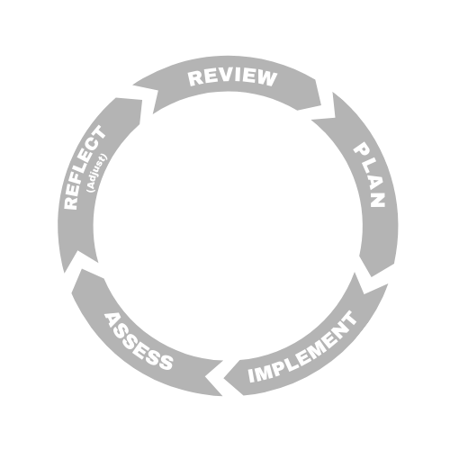



LITERACY
Thornhill Elementary School
Insert School Logo here.
Goal
Improve literacy achievement for all students by building fluency, comprehension, and writing through targeted instruction, consistent school-wide practices, and culturally responsive approaches.
School Actions/Strategy
Targeted literacy groups and one-on-one support.
Literacy and learner support teachers using UFLI for early intervention.
Regular Acadience assessments to track progress.
Leveled reading groups focused on fluency and comprehension.
Daily school-wide D.E.A.R. (Drop everything and read)
Phonics instruction and fluency passages for practice.
School-wide writing approach aligned with BC curriculum, using scaffolding and modeling.
Library curated with a wide range of books at different levels and interests—from chapter books to graphic novels to textbooks—including a robust First Nations section to reflect diverse voices and subjects.
Continued use of oral storytelling to honour Indigenous ways of knowing.
Objectives
Provide targeted intervention for struggling readers and writers.
Strengthen fluency, comprehension, and writing skills across grades.
Use consistent school-wide approaches for reading and writing.
Embed Indigenous oral storytelling and culturally responsive practices.
School Data
School Data & Evidence
Growth in Acadience fluency and reading levels.
FSA reading and writing results.
Results from school-wide writes (fall/spring).
Fluency passage tracking for student growth.
Teacher observations of writing development with scaffolding.
Increased engagement during daily reading and group activities.
District Data & Evidence
Foundational Skills Assessment (FSA).
School-wide write (fall and spring).
Acadience reading level testing and progress monitoring.
Intervention data from literacy/learner support.

Slide 3

NUMERACY
NUMERACY
Thornhill Elementary School
Goal To support all learners in numeracy by identifying students who need targeted interventions, providing enrichment opportunities for those who excel or show strong potential, and ensuring that every student achieves core numeracy benchmarks while developing a deep understanding of mathematical concepts.
School Actions/Strategy
Numeracy Actions here:
Provide manipulatives (base ten, fractions, magnetic sets) in every classroom.
Develop a school-wide numeracy word wall and consistent instructional language.
Run school-wide math challenges with prizes to boost engagement.
Use a variety of programs/resources (Jump Math, Math Makes Sense, online tools).
Reduce literacy barriers in numeracy instruction and assessment.
Continue to apply strategies and resources from Nikki Lineman’s workshops.
Deploy EA and support staff for targeted in-class numeracy support.
Objectives
Improve achievement on school and district numeracy assessments.
Use consistent numeracy language and strategies school-wide.
Increase confidence, engagement, and problem-solving skills in math.
School Data & Evidence
SUMdog math games.
Unit summary tests.
Teacher observations and anecdotal records.
School-wide math challenge participation/results.
District Data & Evidence
Grade 4 Foundational Skills Assessment.
District Numeracy Assessment – Fall & Spring.

Slide 4

INDIGENOUS/INCLUSION EDUCATION
Thornhill Elementary School
Goal
Strengthen connections between school, families, and Indigenous communities. Celebrate and embed Indigenous culture, language, and ways of knowing throughout the school. Support student identity, belonging, and success through cultural inclusion.
School Actions/Strategy
Build strong community connections by attending ceremonies, feasts, graduations, sporting events, and cultural occasions.
Provide wrap-around support through our First Nations Support Worker (attendance outreach, clothing, school supplies, snacks, advocacy, and cultural programming).
Offer Culture Club at lunch with activities such as dreamcatchers, carving, beadwork, and other traditional crafts.
Develop school murals and Indigenous artwork, including the Thornhill Tiger painted in Indigenous design and an upcoming outdoor mural project with community involvement.
Foster inclusive representation by maintaining a school library that highlights diverse voices, including strong Indigenous, 2SLGBTQ+, and multicultural sections.
Support students with Breakfast Club and snack baskets ensuring access to healthy food daily.
Display First Peoples Principles of Learning in classrooms and hallways, along with Indigenous art and language signage.
Promote visibility and safety by placing rainbow stickers and inclusive posters around the school to signal that all students are welcome and respected.
Utilize the outdoor learning space to incorporate land-based learning opportunities.
Objectives
Build and sustain authentic relationships with local communities and families.
Provide culturally responsive learning opportunities for all students.
Increase visibility of Indigenous culture, knowledge, and perspectives in school spaces and activities.
School Data & Evidence
Tracking student involvement in Culture Club and community-based activities.
Documentation of school-wide cultural events and projects (e.g., mural project, outdoor learning space).
Collection development of library resources by Indigenous authors and Nations.
Link to Video of our School, Teacher, and Students:
https://newrelationshiptrust.ca/building-future-skills-through-stem/
District Data & Evidence
Attendance and engagement data.
Student participation in cultural programming.
Feedback from families, students, and staff.

Slide 5

MENTAL HEALTH & WELL-BEING
Thornhill Elementary School
Goal
To strengthen student mental health and well-being by deepening self-regulation skills, fostering belonging, and ensuring consistency of practise across the school.
School Actions/Strategy
Continue consistent school-wide use of Zones of Regulation with posters, daily check-ins, and shared language.
Embed mindfulness and breathing practices through MindUp and classroom chimes.
Support student goal setting through SMART goals in the PE/Health curriculum.
Provide proactive classroom supports (e.g., break cards for self-regulation).
Maintain Breakfast Club 4 mornings/week to support readiness to learn.
Offer extracurricular opportunities that build belonging (sports, traditional culture club, school play, student’s council).
Provide staff professional learning to strengthen consistency and confidence in implementing well-being strategies.
Mental health support from outside agencies.
Objectives
Support all students in developing independence with self-regulation strategies.
Build school-wide consistency in the use of Zones of Regulation and MindUp practices.
Increase opportunities for student leadership, voice, and cultural connections in well-being activities.
Ensure basic needs (such as food security) are met so students are ready to learn.
School Data & Evidence
Student surveys reflecting ability to self-identify emotions/zones and apply regulation strategies.
Increased staff reporting of consistent language and strategies used school-wide.
Growth in student participation in extracurricular and cultural wellness opportunities.
Breakfast Club participation data showing number of students supported.
Parent/family feedback on students’ resilience, well-being, and school engagement.
District Data & Evidence
School District 82 student learning survey data showing needs in social-emotional development and belonging.
District goals aligned with the BC Curriculum Physical and Health Education competencies around well-being, goal-setting, and resilience.
Local data showing importance of food security and extracurricular participation in supporting mental health.

