Slide 1


2025-2026 School Growth Plan
School & Location: Majagaleehl Gali Aks, Gitanmaax, BC
Principal: Shylah Marshall
Issue Date: September 30
HIGH QUALITY INSTRUCTION
Theme & A Statement about Learning: We cultivate high-quality instruction grounded in Gitxsan values, integrating culture, language, and community to support every learner’s growth.
https://cmsd.bc.ca/assets/files/pages/school-plans/School%20Improvement%20Plans/2024-25%20School%20Plans/Majagaleehl%20Gali%20Aks%202024-2025%20School%20Improvement%20Plan%20Video.mp4

Slide 2
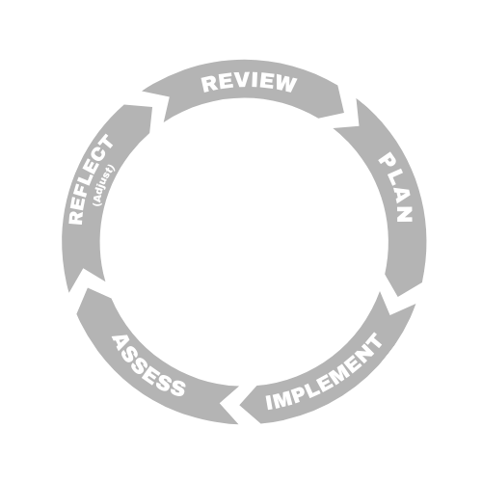


LITERACY
Majagaleehl Gali Aks Elementary School
Goal
Increase the proportion of students reading at or above grade level by June 2026.
School Actions/Strategy
Literacy Actions here:
Implement UFLI programming across all grade levels
Deploy Son au graphème phonics in French immersion with dedicated support
Empowered Reading Program Intervention
Introduce reader’s theatre in English, French, and Gitxsan
Establish a whole-school daily reading block of 30 minutes
Host one family literacy night to engage parents and caregivers
Embed Gitxsan culture through mini feasts tied to literacy themes
Display student-created reading strategies murals in hallways and classrooms
Offer targeted response-to-instruction interventions for students below benchmark
Incentivize reading progress with assemblies and recognition ceremonies
Objectives
Complete UFLI implementation in all K–8 classrooms by June 2026
Deliver three staff PD sessions on reading and writing strategies by January 2026
Conduct 2 monthly reader’s theatre performances by June 2026
School Data & Evidence
Literacy Measures here:
Acadience assessment
French immersion literacy assessments
Attendance improvement
Family literacy night
Reader’s theatre participation in all classes by June 2026
UFLI benchmark assessments (Fall, Winter, Spring)
Report card literacy indicators
Family literacy night attendance
Student self-efficacy surveys in reading and writing
Individual Education Plans (IEP)
Multi-tiered systems support (MTSS)
District Data & Evidence
FSA 4 (reading/writing)
FSA 7 (reading/writing)
Literacy support
Acadience data
School-wide write
K screener
French language assessment

Slide 3

NUMERACY
NUMERACY
Majagaleehl Gali Aks Elementary School
Goal
Boost the percentage of students meeting numeracy benchmarks by June 2026.
School Actions/Strategy
Numeracy Actions here:
Adopt a common numeracy resource with unified language and instructional strategies
Integrate culturally responsive math tasks, linking Gitxsan art and salmon measurements
Collaborate with the library to incorporate STEM literature and numeracy resources monthly
Facilitate math culture events, such as budgeting for mini feasts and salmon celebrations
Connect literacy and numeracy through word-problem writing exercises tied to local contexts
Provide targeted math intervention blocks for students below benchmark
Incorporate technology tools in 50% of lessons
Host one math family night to build home-school numeracy partnerships
Objectives
Encourage teachers to focus on numeracy for one PD
Implement unified math language across all classrooms by September 2026
Integrate STEM literature activities in the library
Conduct one math culture event by June 2026
School Data & Evidence
Numerary Measures here:
Math fluency benchmark assessments (Fall, Winter, Spring)
Report card math indicators
STEM resource usage logs
Student confidence surveys in math
Family event attendance
Baseline math fluency screener
Use of STEM in classrooms
Formative assessment data
Grade level district numeracy
District Data & Evidence
FSA 4
FSA 7
District Numeracy assessments
K-12 Report card data

Slide 4

INCLUSION
Majagaleehl Gali Aks Elementary School
Goal
Raise inclusion and sense of belonging by June 2026.
School Actions/Strategy
Inclusion Actions here:
Deliver instruction in English, French, and Gitxsan across programs
Create an outdoor learning environment for inclusive cultural and environmental education
Establish buddy reading pairs across grade levels to foster peer support
Collaborate between library, classrooms, and cross-program
Offer drumming sessions with the language nest to strengthen cultural identity
Support the use of assistive technology
Schedule cross-grade GLC time for age-appropriate cultural learning
Incentivize attendance and participation through assemblies and leadership opportunities
Maintain daily breakfast and lunch programs to remove barriers to learning
Objectives
Establish buddy reading across K–5 by September 2026
Integrate assistive technology in lessons by January 2026
Facilitate monthly cross-program collaboration meetings
School Data & Evidence
Inclusion Measures here:
Inclusion survey to help show inclusion rates at MGA
Multilingual instructional materials
Outdoor learning sessions
Buddy reading
Cross-program collaboration
EdPlan insight
Student belonging survey results
Cross-program collaboration records
LEA deliverables
Numeracy assessments
Literacy assessments
Report cards
Tracking attendance MYED
District Data & Evidence
Aboriginal How Are we doing report
Local education agreement
Student learning surveys
FSAs

Slide 5

MENTAL HEALTH & WELL-BEING
Majagaleehl Gali Aks Elementary School
Goal
Increase student well-being ratings by June 2026.
School Actions/Strategy
Mental Health & Well-Being Actions here:
Create peer support networks
Fully equip the ISW room to provide wrap-around support daily
Partner with the RCMP liaison to deliver safety and well-being workshops
Provide consistent daily schedules and visible mental health resources in the library
Host monthly mini feasts and salmon celebrations to strengthen community bonds
Implement confidentiality protocols to safeguard student privacy
Engage families through dedicated well-being events
Offer incentives and recognition for positive well-being practices at assemblies
Objectives
Build counselling program with new counsellor
Invite outside agencies in to help with learners
Collaborate with RCMP liaison for workshops
Provide food
Create peer support networks and mental health clubs.
School Data & Evidence
Mental Health & Well Being Measures here:
Initial SEL survey
ISW room usage logs
Student SEL survey (Fall, Spring)
ISW room visitation logs
Family well-being night attendance
Student learning survey
District Data & Evidence
Student learning survey Grade 4 and 7
EDI

