Slide 1

2025-2026 School Growth Plan
School & Location: Kitwanga Elementary School
Principal: Kassia Nameth
Issue Date: November 5, 2025
We are dedicated to nurturing curious minds and compassionate hearts. We are committed to empowering all students to embrace learning, achieve their personal best, and build their emotional, social, and physical well-being. Our school community values respect, kindness, and perseverance. We work to build a nurturing, joyful, culturally responsive learning environment where every child feels valued, supported, and proud of who they are. Together, we envision a future where every student thrives academically, socially, and emotionally, equipped with the skills and confidence to make a positive impact in our world.
School Video link

Slide 2
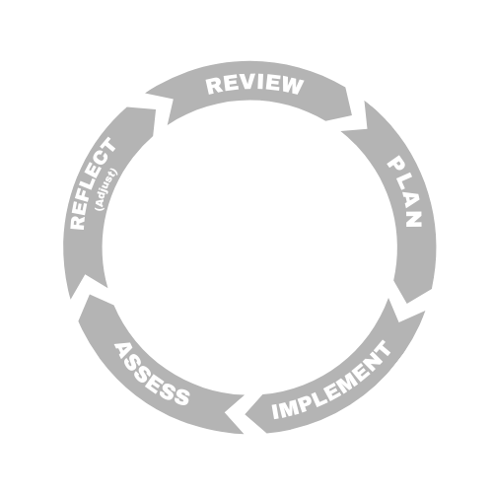



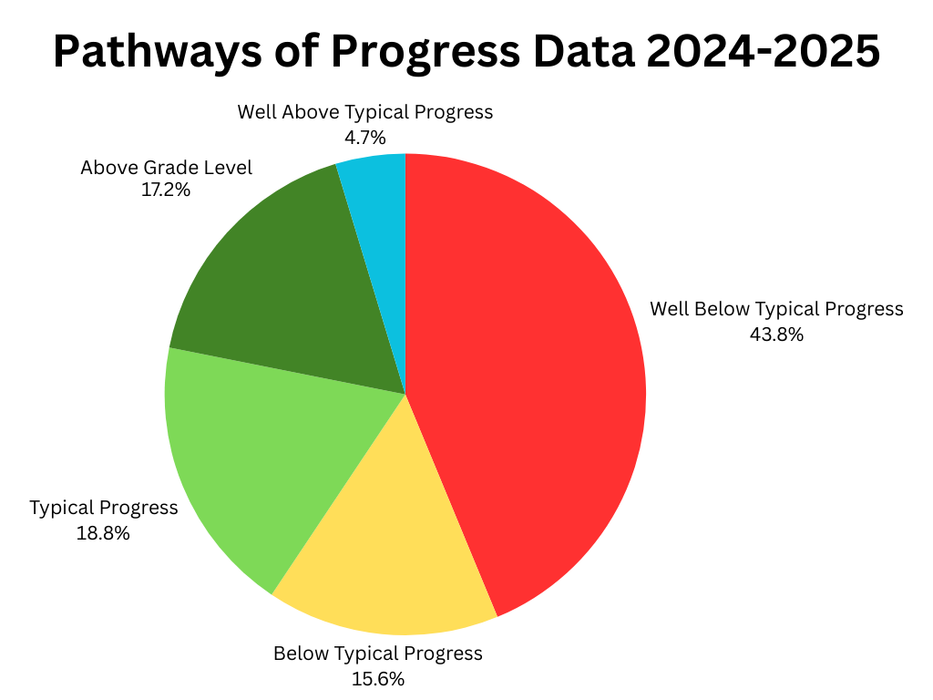
LITERACY
Kitwanga Elementary School
Goal
Our focus is building strong phonological awareness, decoding skills, and comprehension in order to build reading and writing confidence while helping students find joy in reading and writing, with the goal of 75% of students having typical progress or above by June 2026.
Objectives
Use literacy data to drive instruction and differentiate learning in classrooms
Use literacy data to create tier one and two groups to target specific skills
Offer opportunity for students to demonstrate learning in a variety of ways
School Actions/Strategy
Literacy Actions here:
Support new teachers with the implementation of UFLI and the use of Acadience for K-6
Emphasize the benefit of structured literacy programs in classrooms to support literacy learning
Examine Acadience data in staff meetings after each benchmark to monitor growth and establish plans of support
Work as a school team to support students in yellow and red areas in Acadience
Weekly visits to the school library to explore stories of various genres and build a love for reading
Build our inventory of culturally relevant stories and high interest stories by collaborating with students to hear their voices
Implementing the REWARDS reading program for Grade 7 students
Provide more choice to enhance student engagement and activity
School Data & Evidence
Literacy Measures here:
FSA Grade 4
School Wide Write
Acadience Data
Multi-Tiered Systems of Support (MTSS)
Individualized Education Plans (IEP)
District Data & Evidence
FSA 4 (Reading/Writing)
FSA 7 (Reading/Writing)
Acadience Data
School Wide Write
Kindergarten Screener
Acadience pathways of progress data from
2024-2025 school year

Slide 3

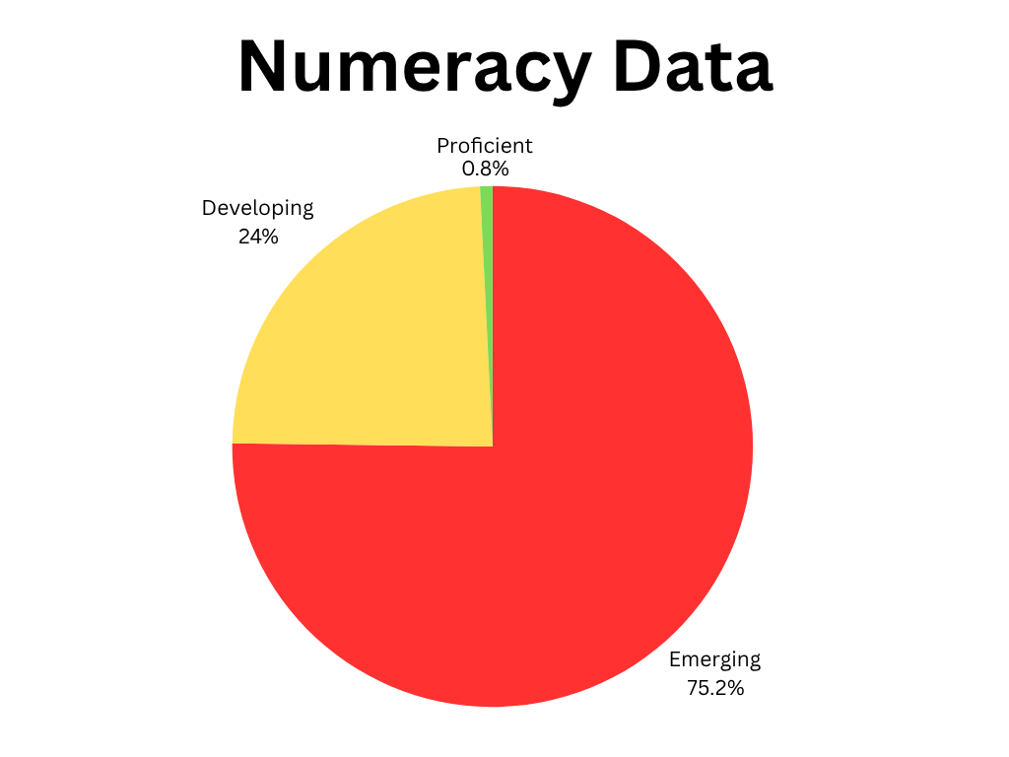
NUMERACY
NUMERACY
Kitwanga Elementary School
Goal
We are dedicated to building curious and confident mathematic learners working towards proficiency in all areas of numeracy. This growth will be supported through inclusive teaching practices and a focus on real-world problem-solving to build engagement through practical mathematical skills.
Objectives
Increase the number of students meeting or exceeding expectations in numeracy by 5% each year.
Review numeracy data after assessments to create data driven instructional interventions for students
Provide professional development opportunities for teachers to explore multiple methods and philosophies of teaching math
School Actions/Strategy
Numeracy Actions here:
Foster a growth mindset and build a positive attitude towards math, emphasizing that everyone is capable of learning.
Collect and analyze data (e.g standardized assessments, classroom assessments, report card marks).
Embed formative assessment practices to guide instruction.
Identify achievement gaps by grade levels, class, and student subgroups.
Implement tiered intervention based on school data.
Develop functional math skills for everyday life, including numerical literacy, logical problem-solving, and the ability to interpret and use mathematical information in all contexts, not just academic settings.
Provide mathematics professional development and exploration in staff meetings throughout the year (math instruction, math assessment, math interventions).
Use diverse approaches to teach mathematics by implementing hands-on learning, visuals, manipulatives, games, and multimodal techniques, including assistive technology, to promote understanding.
School Data & Evidence
Numerary Measures here:
Report Card Results
District Numeracy Data
Anecdotal observations and conversations from staff members and learner support teams
FSA results for Grade 4’s and Grade 7’s
District Data & Evidence
Grade 4 FSA
Grade 7 FSA
District Numeracy Assessment
K-7 Report Card Data
Data from District Numeracy Assessment Grades 2-7

Slide 4

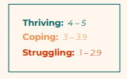

INCLUSION
Kitwanga Elementary School
Goal
Our focus is on fostering an environment that honors, celebrates, and respects culture and diversity throughout our school. We work to build a strong sense of belonging for all students, ensuring they feel seen, heard, and understood. Our goal is to create a community where all learners can thrive together, support one another, and achieve their individual goals.
Objectives
Implement ongoing anti-racism education for staff and students to build awareness, challenge biases, and dismantle systemic racism within the school environment.
Enhance achievement of all learners with emphasis on Indigenous learners, children and youth in care, and students with designations.
Work to reduce the percent of students who miss 20 or more school days in a year.
School Actions/Strategy
Inclusion Actions here:
Establish regular procedures to track and monitor student attendance through MyEd and implement interventions to support student engagement at school and reduce chronic absenteeism
Embed anti-racism and cultural responsiveness in year plans, lesson plans and school events across all grade levels
Integrate Gitxsan language and culture learning into all classrooms, not just during language a culture class. As a school, we will also strive to have a culturally relevant school-wide event each term.
Strengthen family and community partnerships to build strong, supportive relationships that help all learners succeed.
Purchase diverse curricula and materials for the school & library including literature, resources, and activities that represent various cultures, languages, abilities, family structures, genders, and perspectives to engage and represent all students and human diversity.
Review assessment practices throughout the school to work to adapt assessment methods to align with different student abilities, such as written, performance-based, or drawing assessments to ensure inclusive assessment.
Empower students to have their voices heard and partner with them in shaping learning environments that reflect their identities.
School Data & Evidence
Inclusion Measures here:
Report Cards
Tracking Attendance
LEA Deliverables
EdPlan Insight
Numeracy Assessments
Literacy Assessments
Student Learning Surveys Grades 4 & 7
District Data & Evidence
Student Learning Survey Grade 4 & 7
Open Parachute Well-Being Report
Local Education Agreement (LEA)
Foundational Skills Assessment Grade 4 & 7
Open Parachute Well-Being Report data from Grades 4-7

Slide 5


MENTAL HEALTH & WELL-BEING
Kitwanga Elementary School
Goal
Our focus is to help our learners develop, practice, and demonstrate their Social Emotional Learning skills in order to be regulated, ready for learning, and actively contribute to a culture of caring throughout the school. The Open Parachute Student Well-Being Report highlighted that our students seek improvement in the areas of school belonging, absence of sadness, and absence of worries. Our goal is to see a 15% increase in thriving students in the categories of self-management, mental health, and supportive school environment by June 2026.
Objectives
Embed mental health and wellness strategies in classroom instruction
Involve students in planning and evaluating well-being initiative
Collaboration with families and community organization to support children’s mental health
Create peer support networks and
School Actions/Strategy
Mental Health & Well-Being Actions here:
Daily morning mindfulness throughout each classroom to start the day
Implement the use of Open Parachute that includes ready-to-use lessons, check-in prompts, and reflection activities aligned with core competencies such as self-awareness, empathy, and responsible decision-making.
Collaboration with organizations such as Child and Youth Mental Health and Gitxsan Child and Family Services to support students with counselling services, zones of regulation groups, and mindfulness art programs
Implement whole school Positive Behaviour Interventions and Supports
Highlight a Gitxsan Value & Belief each month for students to learn about and practice
Expand clubs and extracurricular opportunities for students.
Provide learners with additional opportunities for ongoing input and involvement in school wide plans and activities – this could be done with the help of a student leadership group or student advisory group
Reconnect with our families and local community by welcoming and inviting them to the school on a regular and ongoing basis
School Data & Evidence
Mental Health & Well Being Measures here:
Student learning survey Grade 4 & 7
Open Parachute Well-Being Report
District Data & Evidence
Student learning survey Grade 4 & 7
EDI (early years)
Open Parachute Well-Being Report
Open Parachute Well-Being Report data from Grades 4-7

