Slide 1
2025-2026 School Growth Plan School & Location: Caledonia Secondary School Principal: Keith Axelson Issue Date: September 29, 2025
We believe in building trusting partnerships with students, parents, and the community to encourage each student to strive for their personal best. We want students to develop and practice skills and attitudes that lead to lifelong learning and develop into mature, responsible contributing citizens.

Slide 2
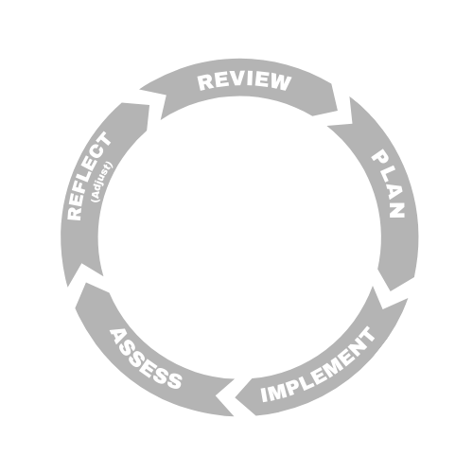



LITERACY and NUMERACY
Caledonia Secondary School, Terrace
Goal
We want to ensure that we are offering programs and supports to students that will develop their literacy and numeracy skills and prepare them for life beyond high school.
Objectives
Offer math courses that meet students needs and abilities.
We offer the opportunity for All students to demonstrate learning in a variety of ways.
Utilize literacy support teacher to assist classroom teachers with supporting students in developing better literacy skills
School Actions/Strategy
Literacy Actions
Literacy Support teacher will develop strategies and resources for classroom teachers to assist students in developing their literacy skills in different subject areas.
ELL teacher develops and delivers educational programs directed at assisting English language learners in developing literacy skills in written and oral form.
Use results from literacy 10 assessment to inform instruction.
Numeracy Actions
Assist students in choosing a math stream that will assist them in their post-secondary planning and allow them to find success.
Use numeracy 10 results to determine focus areas in math courses, and inform instructional strategies.
Other Actions
Support blocks are available to students that need additional supports to succeed in academic courses. Support block teachers liaise with classroom teachers to determine how to support students in different subject areas.
Credit recovery program to allow students time and support to gain credit for courses that they may have not passed, and avoid having to repeat the entire course. Allows students to stay on track for graduation.
School Data & Evidence
Literacy Measures
Literacy 10 and 12 results
Report card data
ELL testing data
Numeracy Measures
Numeracy 10 results
Report card data
Other Measures
EdPlan Insight data
YDI data
Student Learning Survey data
District Data & Evidence
Literacy 10 and 12 results
Numeracy 10 results
EdPlan Insight data

Slide 3


INCLUSION
Caledonia Secondary School, Terrace
Goal
Caledonia will be a school where all students feel welcome and cared for. We want all students to feel a sense of belonging where they can fully participate in their educational program and develop a future plan of their choosing.
Objectives
Reduce student absenteeism and increase engagement.
Enhance opportunities for inclusive activities and programs.
Work with staff to develop tiered interventions to support student success.
Develop anti-racism strategies and education for staff and students.
Be a culturally responsive school community
School Actions/Strategy
Inclusion Actions
Monitor attendance and maintain close communication with families to promote regular attendance.
Support initiatives to enhance indigenous cultural and educational opportunities.
Utilize the Indigenous Graduation Advisor to track indigenous success rates, attendance, and to maintain close communication with families and education coordinators.
Ensure that all students have equitable access to programs.
Continue with the International Student Club to celebrate cultural diversity at Caledonia.
Offering all girls PE 10 classes to promote engagement.
Caledonia Travel Club provides students opportunities to experience different cultures around the world.
ELL program to remove language barriers for students learning the English language.
Students have agency at the high school to choose programming that interests them and assists them with their post-secondary planning.
School Data & Evidence
Inclusion Measures
Track academic success rates for all students
Tracking Attendance (MyEd)
LEA Deliverables
EdPlan Insight data
Student Voice results
High School Graduation Pathway Tracking
Numeracy Assessments
Literacy Assessments
Track participation rates in extra-curricular activities
District Data & Evidence
Aboriginal How Are We Doing Report
Local Education Agreement (LEA)
Student Learning Survey Grade 10 and 12
YDI (Secondary Years)
Student Learning Survey
Adolescent Health Survey
Student Voice

Slide 4


MENTAL HEALTH & WELL-BEING
Caledonia Secondary School, Terrace
Goal
At Caledonia, we are committed to providing a place where students feel safe and accepted, and cared for. The mental health and wellbeing of all members of the Caledonia community will be prioritized in all decision-making.
Objectives
Embed mental health and wellness strategies in classroom instruction.
Build a school-wide culture of care and connection.
Provide robust and diverse extra-curricular opportunities for students.
Build and maintain connections with outside agencies to help support students.
School Actions/Strategy
Mental Health & Well-Being Sample Actions
Promote trauma-informed practices and approaches in classrooms and school-wide.
Clubs day at the beginning of September to promote extra-curricular opportunities for students.
Provide cultural activities and opportunities for indigenous students to help build connections to culture, and a sense of pride in students.
Invite outside agencies into the school to provide mental health services to students.
Use student voice to drive programs and opportunities for students.
Continue to offer support blocks and alternate classroom spaces to accommodate students who need support in their schooling.
School Data & Evidence
Mental Health & Well-Being Sample Actions
YDI data
Student Learning Survey
Student Voice sessions
Data from Indigenous Support Workers and Counsellors
Anecdotal Information
District Data & Evidence
Student Learning Survey Grade10 and 12
BCAHS (BC Adolescent Health Survey)
YDI (Secondary Years)
EdPlan Insight data

