Slide 1

2025-2026 School Growth Plan
School & Location: New Hazelton Elementary
Principal: Mark Newbery
Issue Date: September 29, 2025
HIGH QUALITY INSTRUCTION
Theme & A Statement about Learning: ⇦ Rooted in Community, Growing through Literacy and culture. Learning is nurtured by the strength of community. Literacy is the foundation for growth, empowering every learner to think deeply and critically, connect meaningfully, and contribute to the world beyond their rural home.
New Hazelton Elementary School Improvement Plan 2025-2026.mp4

Slide 2
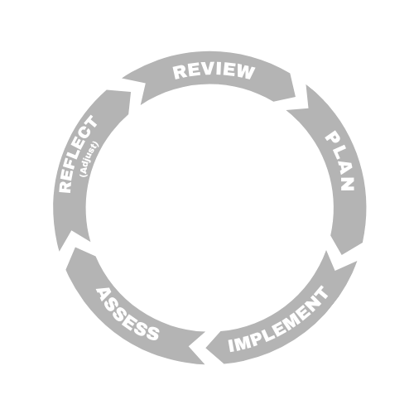



LITERACY
School Name –New Hazelton Elementary School
Goal : All students will develop strong reading, writing, speaking and listening skills enabling them to become confident, deep, critical lifelong learners
School Actions/Strategy
Literacy Actions
- Implement a structured approach to teaching literacy
- Use universal screeners first to assess students and guide instruction, followed by diagnostic screeners and regular assessments to further support instructions.
- Support all staff with implementation of robust, research-based literacy programs such as UFLI and Joyful Literacy.
- Use of First Peoples Principles of Learning to support literacy instruction.
- Increased use of Tier 2 instruction and supports within the classroom as opposed to pull-outs.
- Implement Empower Literacy for Tier 3 intervention.
- Use of level B assessments to guide literacy instruction while work continues towards psychology assessments.
Objectives
Use robust, research based assessments.
Use data from these assessments to drive instruction.
Family and community will be involved in supporting and celebrating literacy development
School Data & Evidence
Literacy Measures here:
- FSA grades 4 and 7
- School Wide Writes
- Acadience Data. This includes universal screeners and progress monitoring
District Data & Evidence
- FSAs
Acadience Data
School-Wide Write
The decisions we make must be grounded in data and robust research.

Slide 3

NUMERACY
NUMERACY
School Name – New Hazelton Elementary School.
Goal: All students in Kindergarten to Grade 7 will deepen their understanding of numeracy by developing problem-solving strategies that connect mathematic concepts to community and indigenous ways of knowing, such as FPPL.
Objectives
1. Engage in best instructional practices for teaching numeracy that are driven by robust assessments and data.
2. All students recognize that mathematics exists in every day life and culture.
3. All students will meet numeracy expectations by the end of grade 3.
School Actions/Strategy
Numeracy Actions here:
Use robust assessments to gather data that drives instruction
Implement tiered interventions
Track student learning and skill acquisition using regular assessment.
Use of formative and summative assessments to guide instruction – report cards, standardized assessments such as FSAs and district assessments.
Encourage collaborative planning and sharing successes across staff and with other elementary schools
School Data & Evidence
Numerary Measures here:
Report Card Data
Qualitative and Quantitative observations
Ongoing conversations with staff and learning support
District Data & Evidence
FSAs grades 4 and 7
Report card data
District numeracy assessment
The decisions we make must be grounded in data and robust research.

Slide 4

INCLUSION
School Name – New Hazelton Elementary School
Goal – Create and maintain an inclusive school environment where every member of the school community, regardless of background, learning style, ability, or culture feels valued and supported to succeed academically and socially.
School Actions/Strategy
Inclusion Actions here:
Attendance: monitor student attendance, implementing early interventions such as, responsive outreach, working along side ISWs, Education Coordinators, and families to address absenteeism and support engagement.
Embed culturally responsive approach in overviews, lesson plans, school-based activities
Ensure that students, staff, and families can see themselves reflected in the school environment.
Explore the use of role models in the school.
Consistent review of codes of conduct and policies such that restorative relationships can be a focus where and when appropriate.(
Objectives
Support a culture of belonging through inclusive school practices.
Provide professional development for staff on diversity, and inclusive educational strategies such as universal designs for learning
Implement differentiated instruction.
School Data & Evidence
Inclusion Measures here:
Student, staff, and community voice recorded qualitatively and quantitatively.
Literacy and numeracy assessments.
Attendance records
Report Cards
Qualitative and Quantitative data tracking community engagement in school events such as parent/teacher nights.
District Data & Evidence
- Local Education Agreements
Student Learning Surveys
MDI
FSAs
Health Surveys

Slide 5

MENTAL HEALTH & WELL-BEING
School Name – New Hazelton Elementary School.
Goal – promote and support the well-being of all students, staff, and families by creating a supportive school environment that encourages resilience, compassion and self-regulation and an understanding of mental health that is grounded in robust research.
School Actions/Strategy
Mental Health & Well-Being Actions here:
- explore resources that are available for supporting classroom instruction that allow for a common, school wide language and understanding of mental health and well-being. Such resources could include – Mind Up, Zones of Regulation, Open Parachute, local health authorities.
Support all staff with accessing research-based information around health and wellbeing that is relevant to supporting them personally.
Ensure that communication through monthly news letters, weekly blasts, emails to parents provide information around mental health and offer links to local support services.
Objectives
Integrate social-emotional learning into classroom instruction and school activities.
Provide staff with robust, research driven training that brings a tempered approach to supporting mental health needs.
Provide resources, counseling, and early interventions for students in need.
Create peer support networks and mental health clubs.
School Data & Evidence
Mental Health & Well Being Measures here:
Student learning Survey
student voices – qualitative and quantitative data
attendance of both staff and students
District Data & Evidence
Student Learning Surveys
EDI
MDI
Student Voice

