Slide 1
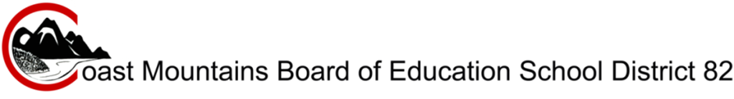
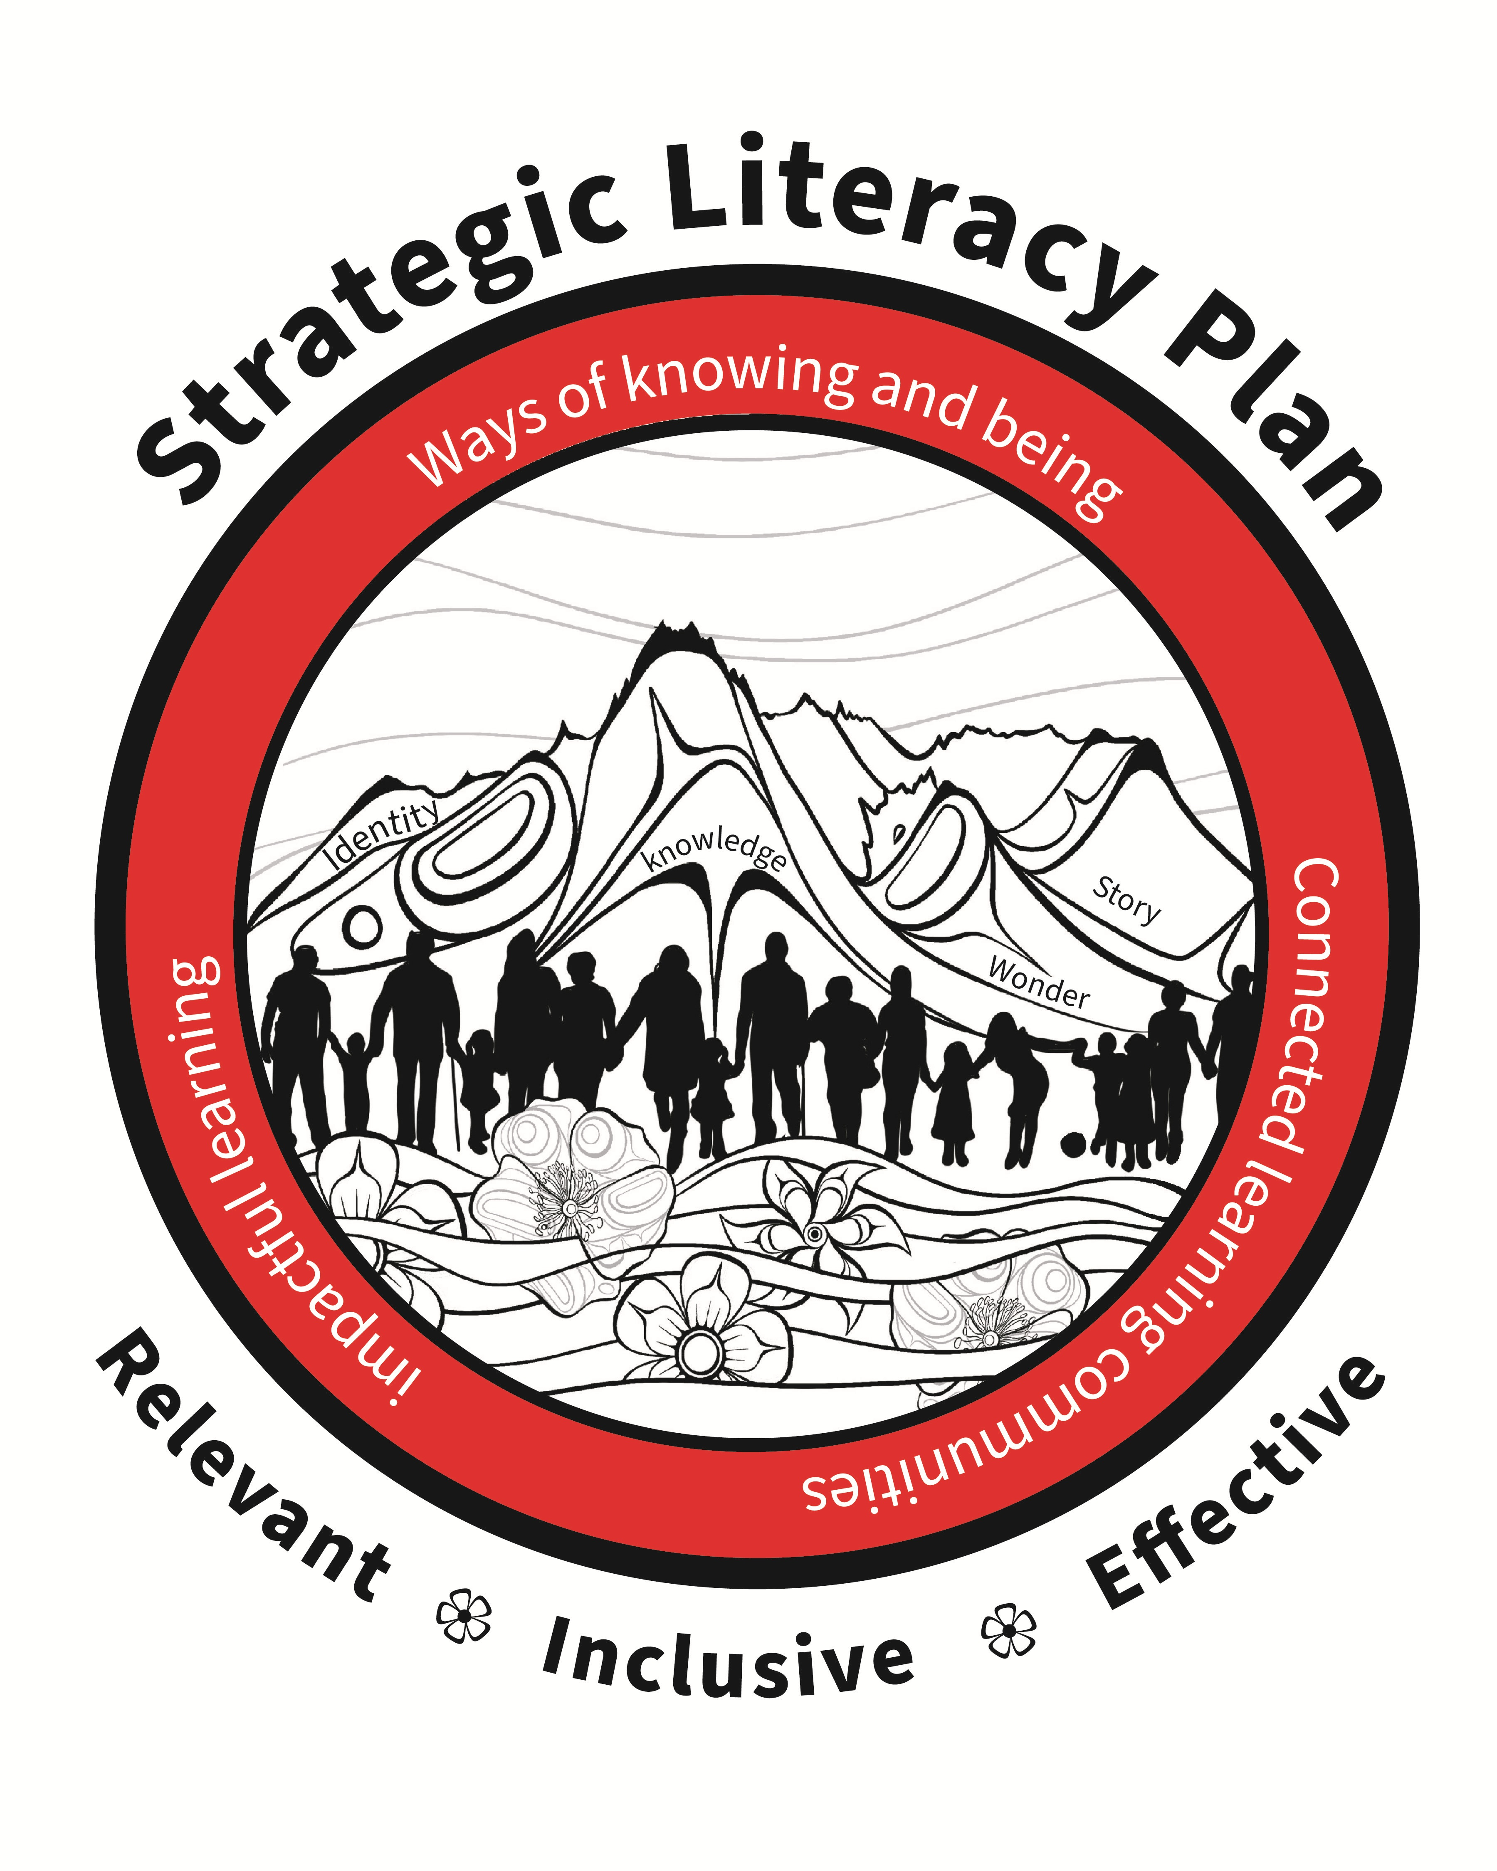
Art and Design Work by Michelle Stoney
We call the children “Majagalee”. Sweet, wild flowers fed from the mist, showered with knowledge and love. Deeply rooted in the land, they are the oldest stories, told and retold.”
Shawna Davis

Slide 2
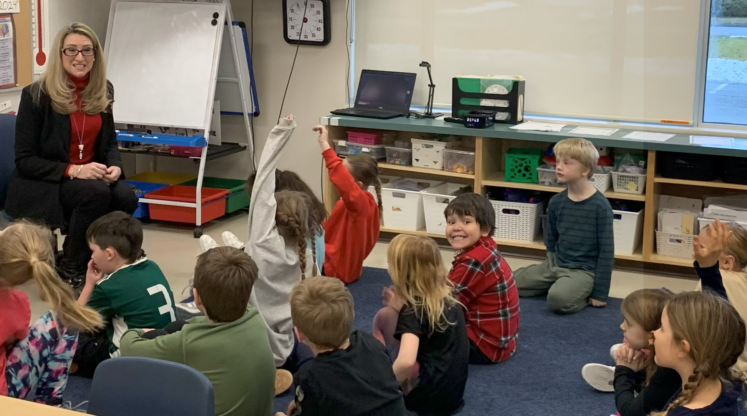
Coast Mountain School District is situated on the traditional and unceded territories of the Gitxsan, Haisla, Nisga’a and Ts’msyen Peoples and serves 4 100 students in a large and diverse geographic area.
A Message From CMSD Superintendent Tracey MacMillan
We are proud to share the Coast Mountains School District’s Strategic Literacy Plan with you. Rooted in the Board of Education’s vision to Engage, Ignite, Empower, this plan reflects the collective wisdom of educators, families, leaders, and partners who contributed their voices to its development. We are deeply grateful for the dedication and collaboration of everyone who worked together to shape this framework. It is grounded in research-based practice, enriched by place-based and cultural perspectives, and focused on equity and inclusion. At the heart of this work are the Majagaleehl—the children we serve—whose success and growth inspire us to continually improve. By working together, we will ensure that literacy learning in our schools is relevant, inclusive, and effective, empowering every student to realize their full potential.
2

Slide 3
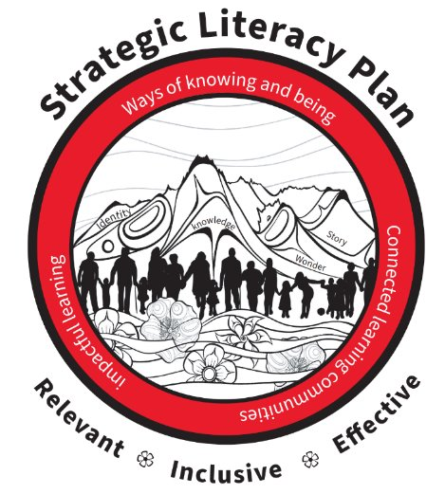
ABOUT THE COVER ART
This piece on the cover was chosen because it illustrates the connection between the place, people and wisdom. On these beautiful unceded traditional territories, our schools are grounded in the strength and shared knowledge of collaborative communities. Our hope is that by working together to improve literacy outcomes, the Majagaleehl, the children our schools serve, will achieve success and growth so great it makes the Coast Mountains that surround us themselves seem small.
The text included in the cover art was carefully chosen to reflect the goals, strategies and values of our literacy plan, rooted in the people and place shown in the beautiful artwork.
The plan’s three core goals are on the bottom in bold: relevant, inclusive, and effective. This literacy plan strives to be culturally relevant, inclusive of all learners, and effective in improving student outcomes.
Surrounding the image are key practices that bring the plan’s goals to life. We plan to embed ways of knowing and being that authentically include Indigenous wisdom, foster connected learning communities that grow professional capacity in the essential pillars of literacy, and support impactful learning experiences that help our students’ literacy flourish.
In the mountains are the plan’s values of identity, wonder, story and knowledge. These words remind us that literacy is a rich, multifaceted experience that is deeply meaningful to individuals, communities and cultures.
The cover art for this literacy plan was created by Michelle Stoney, a Gitxsan and Cree artist who resides in Gitanmaax. It is an honour to have such a celebrated local artist contribute her beautiful work to this plan. We are so grateful for her work. More about Michelle can be found on her website: https://www.mstoneyart.ca/
3

Slide 4
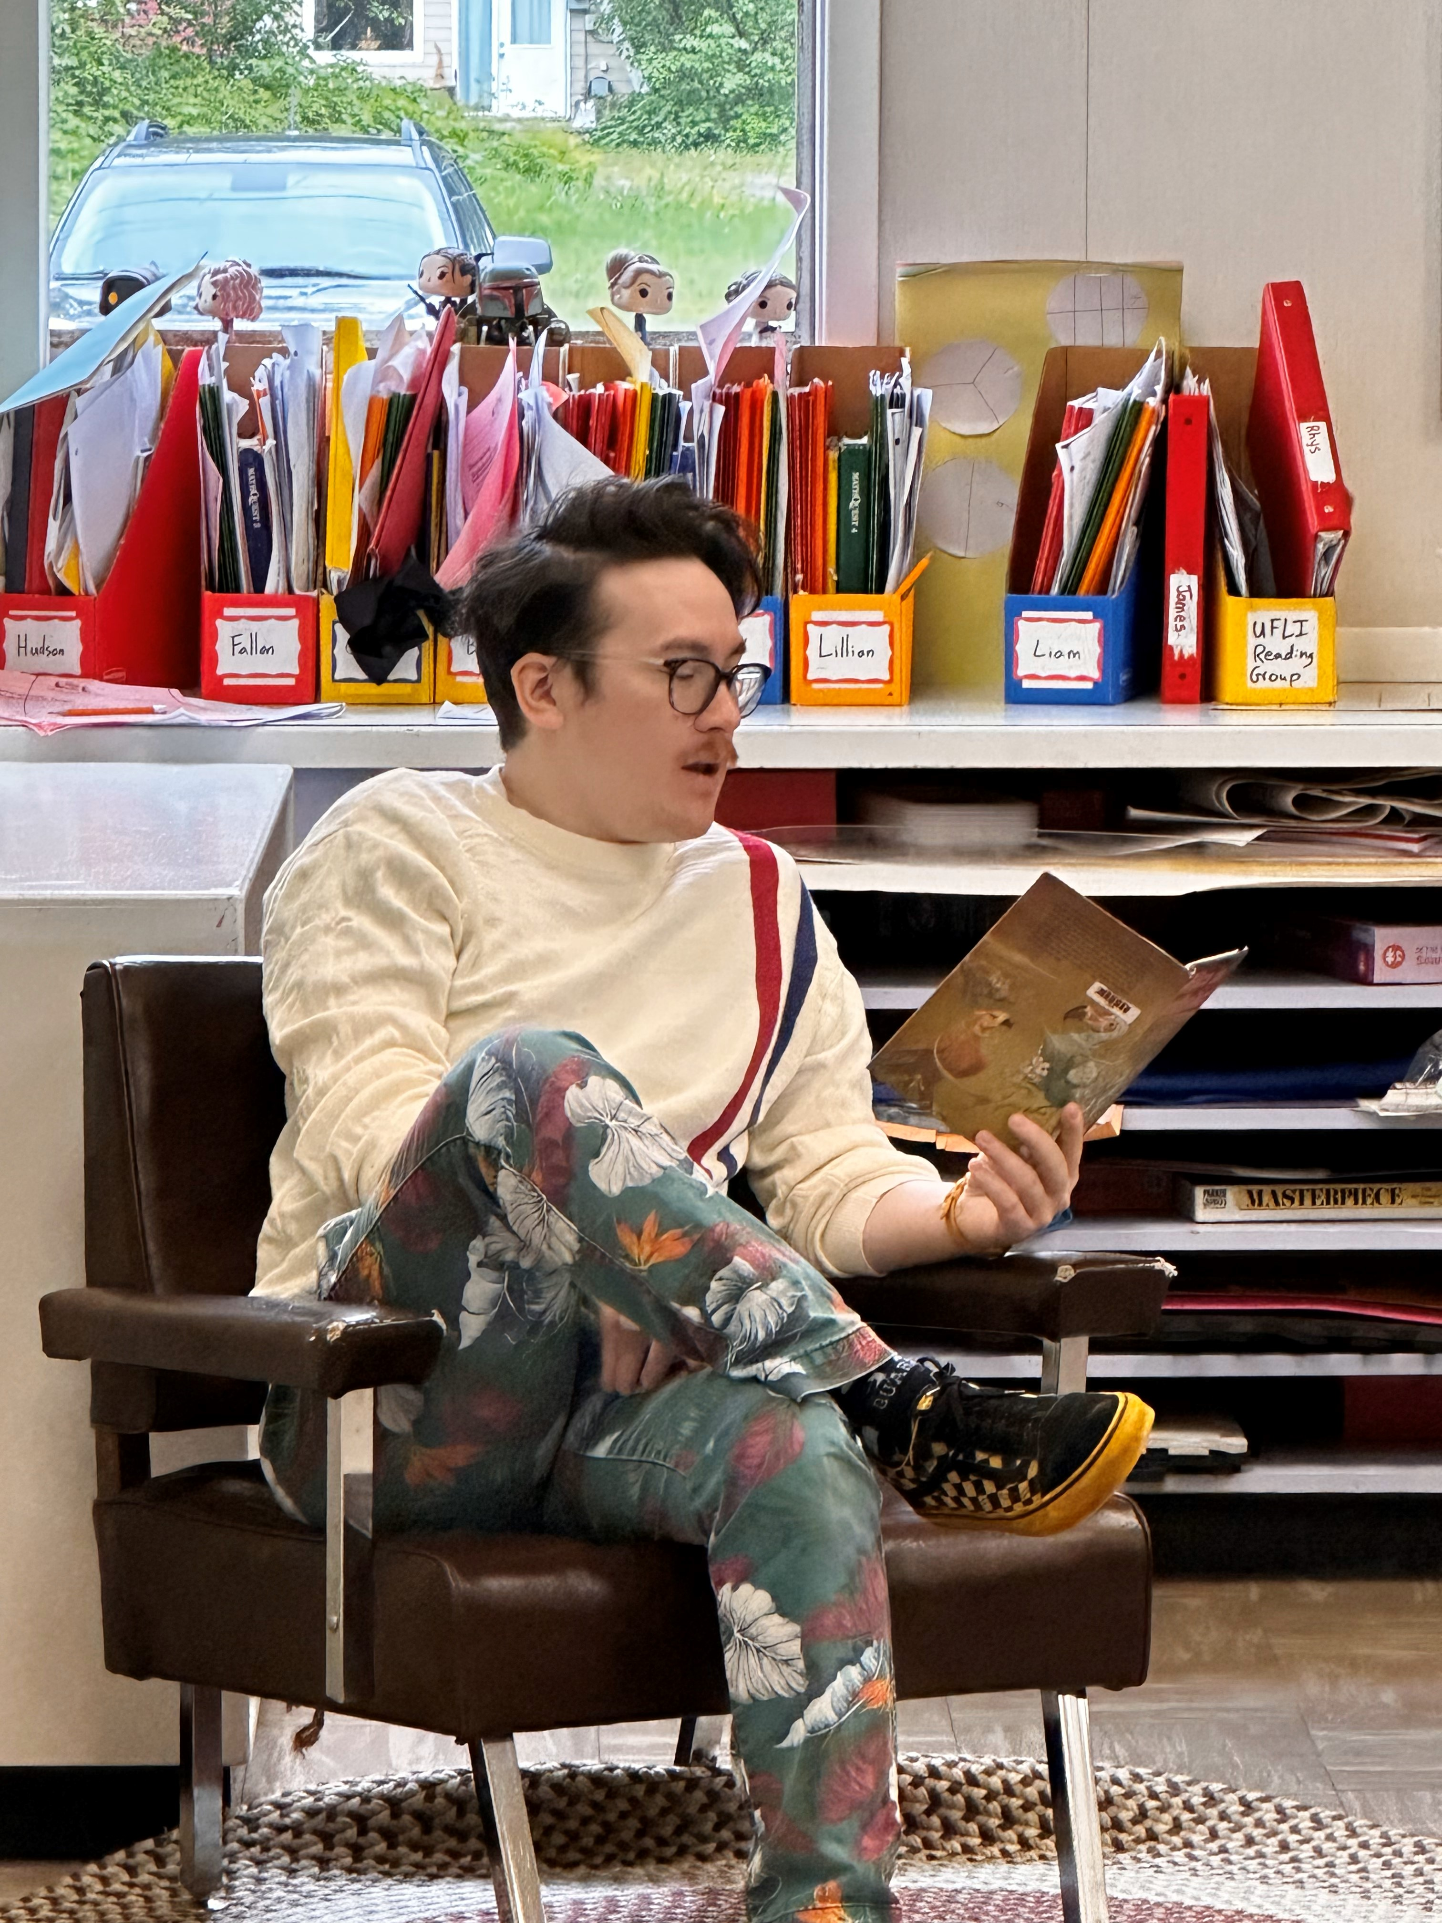
ABOUT THE PLAN
Coast Mountains School District Board of Education's Strategic Plan Engage, Ignite, Empower has the following three goals: All Students Realizing Their Full Potential, Honouring and Respecting Culture, Diversity, and Inclusion, and Well-being Within the Educational Community. An aspect of the first goal is a focus on essential literacy skills, which is the plan addresses.
Check out this video made by POPARD (Provincial Outreach Program for Autism & Related Disorders) to see highlights of the literacy work CMSD is doing here
Development Process
This framework was developed through a collaborative process among teachers, leadership, researchers and district partners that involved conversations, surveys, focus groups and feedback. DrJamie Metsala, Melanie Baerg, and Christine Williams provided guidance and professional learning regarding effective literacy practices and support systems. It embodies the collective wisdom of the Coast Mountains School District community who strive towards the goal of bettering the lives of students through improved literacy outcomes.
Overview
The path to this goal in our plan involves supporting staff and students using research-based practice applied in context using the input from the above-mentioned collaborative process and wisdom. Key elements of the plan include place-based cultural relevancy, screening and progress monitoring, Multi-Tiered Systems of Support, professional learning opportunities, and support for effective instruction and resources.
4

Slide 5
GROWTH TO CELEBRATE
Since the start of district literacy initiatives, results from screening show improvements. Universal screening started in the fall of 2023 for students in Kindergarten to Grade 3. When 2024-2025 year-end results are compared to 2023-2024 results for the same group of students, there are improvements in the number of students performing At or Above Benchmark and reductions in the number of students Well Below Benchmark.
4–6
5

Slide 6
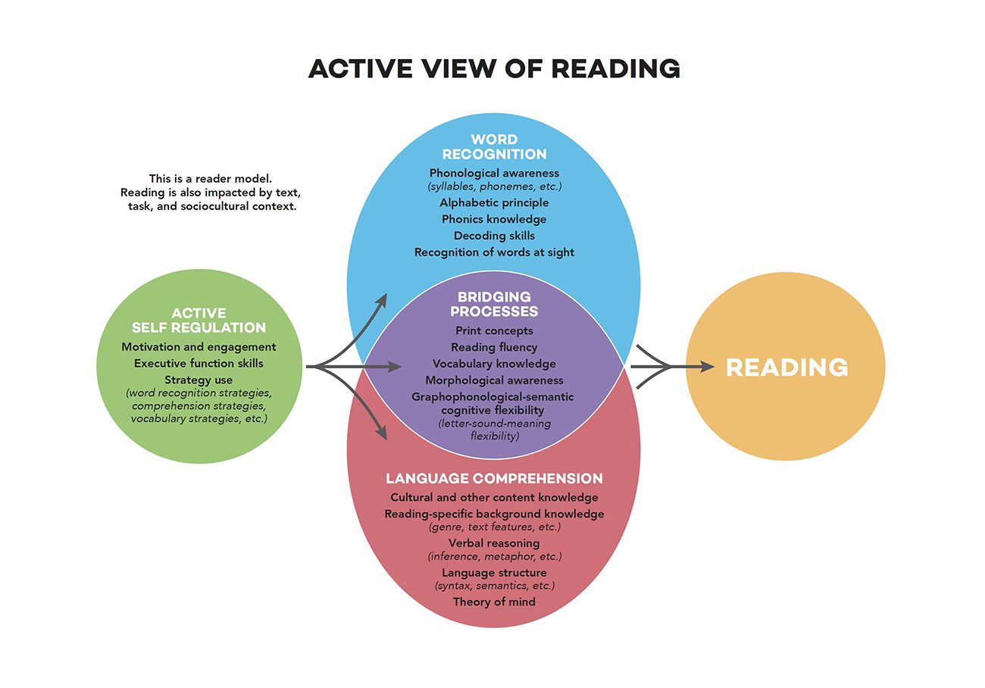
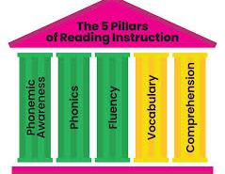
LITERACY RESEARCH
This plan is grounded in scientific research about literacy instruction, which is a wide body of research on how children learn to read and write and how schools can effectively teach students literacy . The plan promotes a comprehensive and research-informed approach to literacy instruction across the district.
The Active View of Reading reminds us that reading is a complex process with many elements that are required for readers to understand the text they are reading.
While the Active View explains how people proficiently read, the 5 Pillars are the essential foundational reading skills that should be taught. CMSD K–6 instructional frameworks included all these pillars.
6

Slide 7
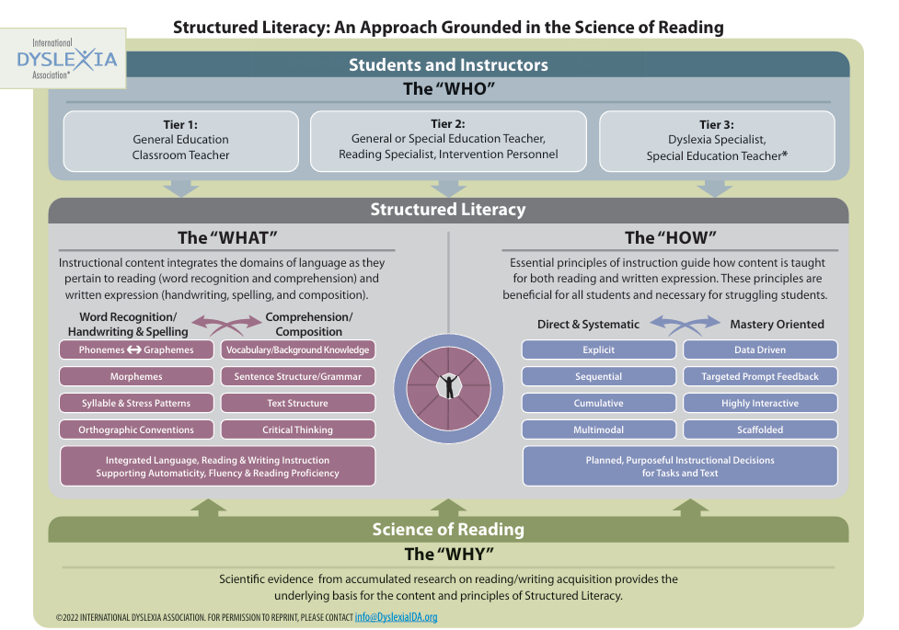
Structured literacy approaches are encouraged because they can benefit all students, especially those with diverse learning needs and disabilities. It supports comprehensive literacy development through effective teaching principles that improve literacy outcomes.
Structured literacy emphasizes explicit and systematic teaching of literacy components.
Explicit instruction involves the teacher clearly explaining and modeling key skills so that students understand exactly what is being taught and how to apply it. Students then practise what they learned through a gradual release of responsibility.
Systematic instruction follows a carefully planned sequence, ensuring that simpler skills are taught and mastered before moving on to more complex ones.
Literacy components are both foundational literacy skills, such as decoding and spelling, and higher-level skills, including reading comprehension and written expression.
Check out this video from the International Dyslexia Association of the work our school district has been doing here
7

Slide 8
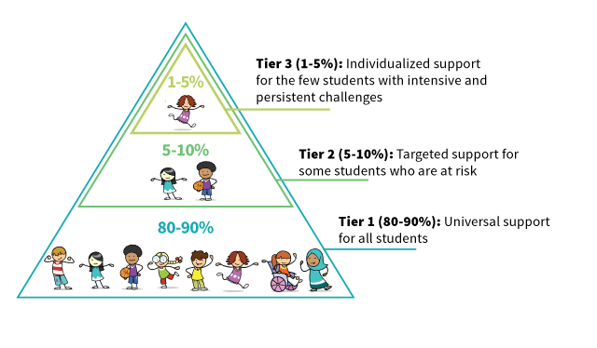
MULTI-TIERED SYSTEM OF SUPPORTS (MTSS)
CMSD’s literacy plan is structured using MTSS. Based on screening and other assessment, supports intensify with greater need. Teachers use MTSS for planning and providing instruction and intervention.
Benefits of using a MTSS for literacy are that it helps:
Identify students' needs – MTSS uses screening and diagnostic tools to help teachers identify students' academic, behavioral, and social-emotional strengths and challenges.
Provide differentiated support – MTSS allows teachers to create individualized support plans for students based on their needs.
Reduce barriers to learning – MTSS helps schools intervene quickly with struggling students to reduce or remove barriers to learning.
Improve student performance – Research shows that MTSS can improve student academic performance and reduce suspensions and referrals.
Enhance problem-solving skills – MTSS can help students develop problem-solving skills.
8

Slide 9
MTSS is a framework that uses a continuum of evidence-based practices and three tiers of support:
Tier 3
Tier 2
Tier 1
Provided in addition to Tier 1 Supports and Tier 2 Supports.
The greatest level of support
Provided to some students who may need more support in addition to Tier 1 instruction.
Intervention is provided to small groups on a specific skill.
Progress is monitored on the skill.
Provided to ALL students to support their academic, social-emotional, and behavioural growth.
Schools plan and deliver high-quality instruction to assist students in meeting grade level expectations.
Teachers differentiate to support student access to content.
Teachers provide reteaching and reinforcement.
9

Slide 10
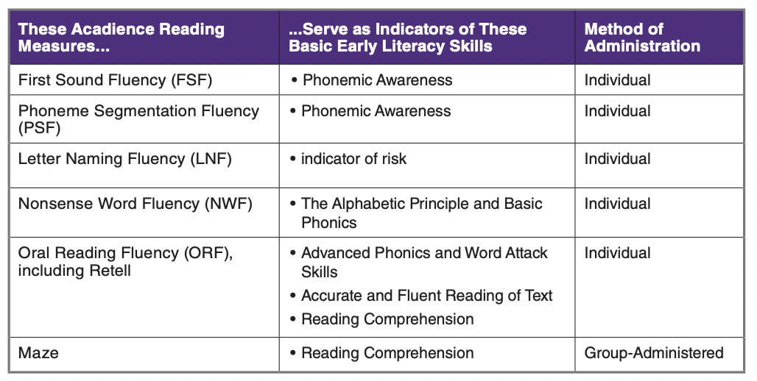
SCREENING AND MONITORING
In April 2024, the BC Government announced that they would be working with all school districts to implement evidence-based early literacy screening for all students from kindergarten to grade 3. The Ministry of Education requires literacy screening for all kindergarten students at a minimum in Fall 2025. As a key element of our plan, the district is using Acadience for all students in kindergarten through to grade 6. Acadience meets the criteria established in BC's Early Literacy Screening Tools Resource. CMSD is a leader that is exceeding expectations implementing and using evidence-based early literacy screening. This screening helps identify the supports students need that is then provided using the MTSS tiers.
Benchmarking
Acadience literacy screening takes place through benchmark assessments that occur three times each school year for all students in kindergarten through to grade 6. The assessments are brief and effective indicators of foundational literacy skills including, phonemic awareness, phonics, fluency, comprehension and vocabulary. These brief evidence-based assessments help determine which students need additional literacy support and tier 2 and/or 3 intervention. The screening also helps show growth in foundational literacy skills across the year that can be celebrated with students and families.
Progress Monitoring
Based on Benchmark results and other sources of information, students whose growth is not as expected can be enrolled in progress monitoring on Acadience.
Progress monitoring helps track the skills that intervention is targeting. This helps to keep track of a student’s progress and determine if the current instruction and intervention is the best fit. Progress monitoring materials can be individualized to a student’s instructional level rather than grade level if needed. Progress monitoring typically occurs every one to three weeks.
10

Slide 11
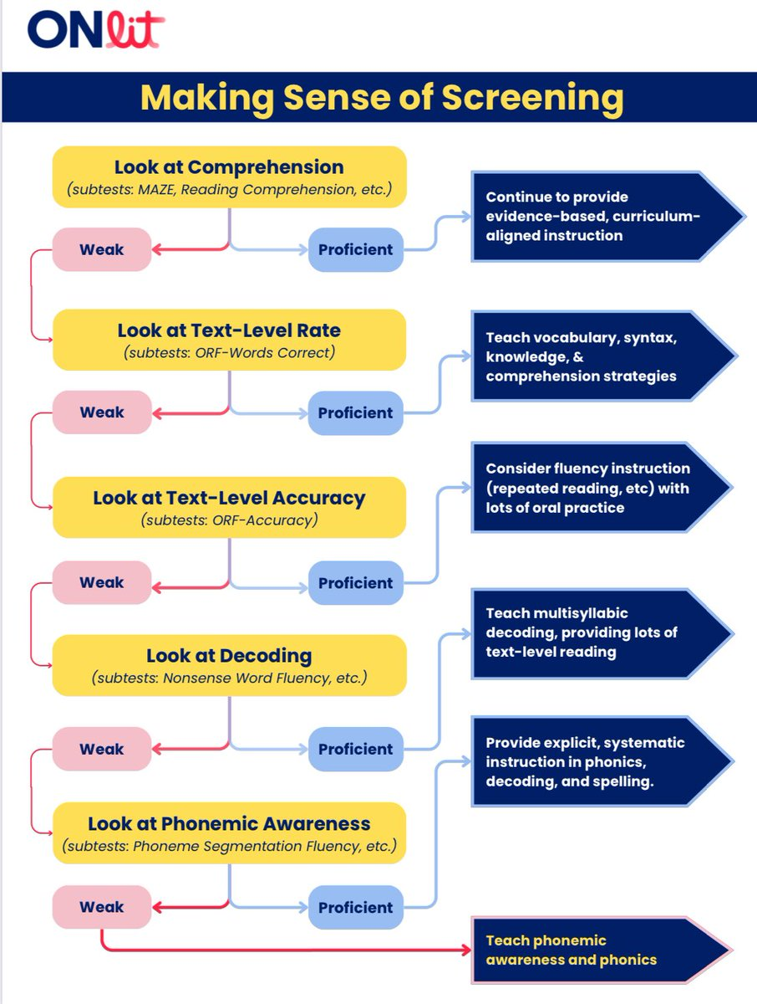
After screening, the next step is to form targeted Tier 2 or 3 literacy intervention groupings based on student needs using Acadience and information from other assessments. Acadience provides suggested groupings based on essential skill proficiency. To further refine these groups and determine what specific skills students need support to learn, teachers can refer to tools like the Decision Tree from Onlit, as shown above. They can also conduct additional assessment if needed.
Example: if a student had difficulty decoding on the Nonsense Word Fluency (NWF) component of Acadience, administering a phonics screener, such as the Core Phonics Screener, can also help identify specific decoding challenges and determine the most appropriate starting point within the UFLI Foundations lesson sequence.
11

Slide 12
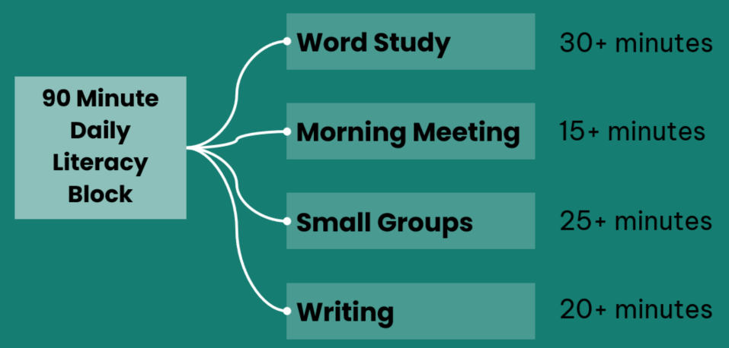
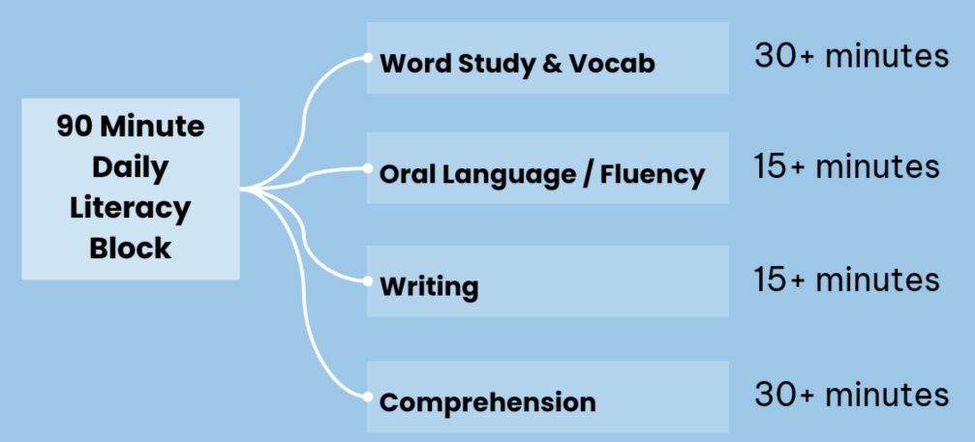
INSTRUCTIONAL FRAMEWORKS
The frameworks were created in a collaborative process involving K–8 teachers across the district, who contributed their experience, ideas, and resources to ensure the models reflect structured, effective practices that works for our context. These frameworks also help meet BC’s curricular standards and Foundational Learning Progressions.
They were developed as resources for staff to support the implementation of comprehensive Tier 1 and 2 literacy instruction that is intentional, explicit, and systematic. They are flexible and can be adapted to student interests, needs, and curricular connections across learning areas. Below are the overview of the K–3 and 4–6 blocks:
K–3
4–6
12

Slide 13
SUPPORTING INDIGENOUS LEARNERS
Literacy is important to Indigenous students for many reasons, including:
Cultural identity
Literacy can help Indigenous students develop a deeper understanding of their cultural history and traditions. It can also help them feel confident in who they are and where they come from.
Quality of life
Strong literacy skills developed before the age of 9 are directly correlated with a student's overall quality of life as an adult.
Orality
Orality is a traditional literacy skill that is still important today. Children should be encouraged to listen to and tell stories from a young age.
Language
Literacy in both traditional languages and English is important for Indigenous students.
Information literacy
Information literacy is a set of abilities that enable individuals to evaluate and choose information critically from a range of sources.
Some strategies for supporting Indigenous students' literacy include:
Incorporating Indigenous ways of knowing into teaching
Encouraging family and elder involvement in literacy initiatives
Providing instruction in traditional language when fluent speakers are available
Using an abundance model that focuses on a child's positive development and strengths
“If we expect less from First Nations, Inuit, or Métis learners academically, we are negatively impacting their options in life once they leave the K-12 system.”
~ Jo Chrona
13

Slide 14
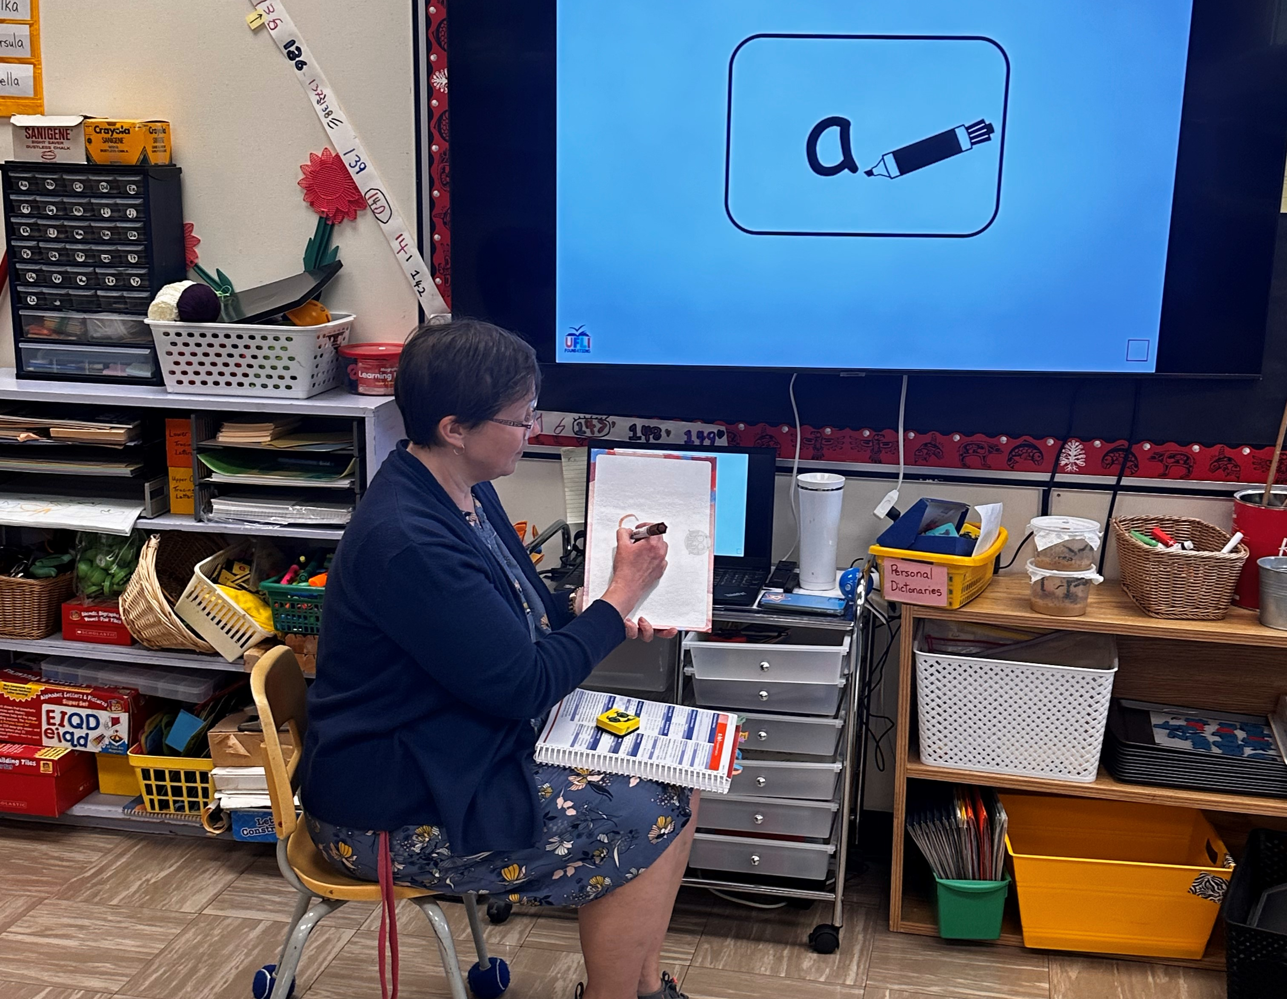
PROFESSIONAL LEARNING
Coast Mountains School District has made professional learning a key part of its literacy work. Since 2023, educators have taken part in focus groups, in-service training, and collaborative sessions to develop K–6 literacy frameworks. These sessions blended research-based strategies with teacher expertise. Staff have also attended conferences and received in-service on Acadience and University of Florida Literacy Institute Foundations Program (UFLI).
Currently, teachers are supported through UFLI and Acadience training, mentorship from school-based literacy leads, and access to aligned instructional materials. Kindergarten teachers have met with district leaders to address screening challenges, and surveys are helping guide improvements. Regular collaboration and coaching ensure consistent support across all schools.
Looking ahead, the district will expand training in areas such as writing, offer new learning opportunities focused on literacy research, and maintain annual check-ins with teachers. Secondary literacy focus groups will be introduced, and ongoing investments in resources, leadership, and partnerships will help build long-term capacity.
14

Slide 15
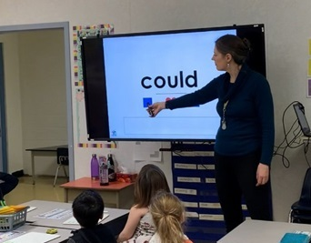
RESOURCES
One key aspect of Coast Mountains literacy framework is investing in and providing effective resources. Our focus has been on promoting and sourcing evidence-based resources as well as authentic Indigenous resources. The goal of this is to equip teachers with resources that will deliver high-quality Tier 1 and 2 instruction. Examples of resources include:
UFLI Foundations is an evidence-based resource that is supported in our elementary schools. To support this program, kits of materials required for teaching were made and sent to all schools. UFLI is becoming widely adopted in primary classrooms and as a Tier 2 intervention.
Additionally, all schools have received Cedar School Decodables—a set of 20 books for Kindergarten and Grade 1 students (ages 4–7). Written by an Indigenous author in collaboration with Dyslexia Canada, the series builds on basic phonics and increases in complexity across six progressive sets.
Curated resources can be found in the school district’s K-3 and 4-6 literacy block framework documents.
15

Slide 16
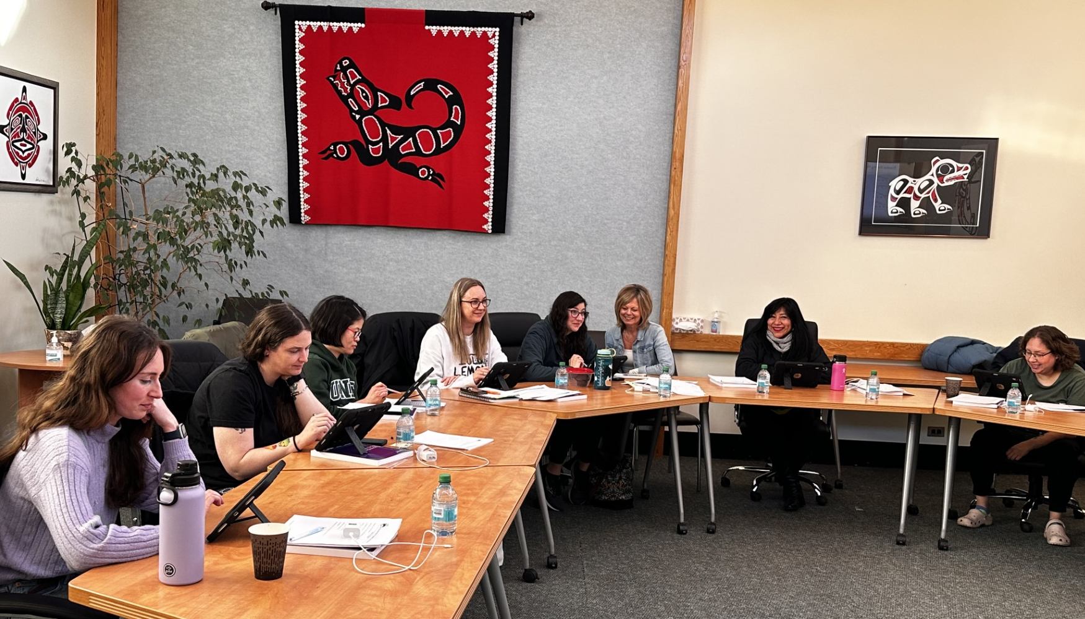
NEXT STEPS
In the 2025–2026 school year, we plan to:
Continue K–6 reading support, resource acquisition, and professional learning
Providing and promoting professional learning on
effective writing instruction
Progress monitoring
Forming of a middle and secondary literacy focus group to develop a literacy block framework for grades 7–12.
“Literacy and numeracy results are important indicators of the educational success of First Nation learners”
~ First Nations Leadership Council
16

Slide 17
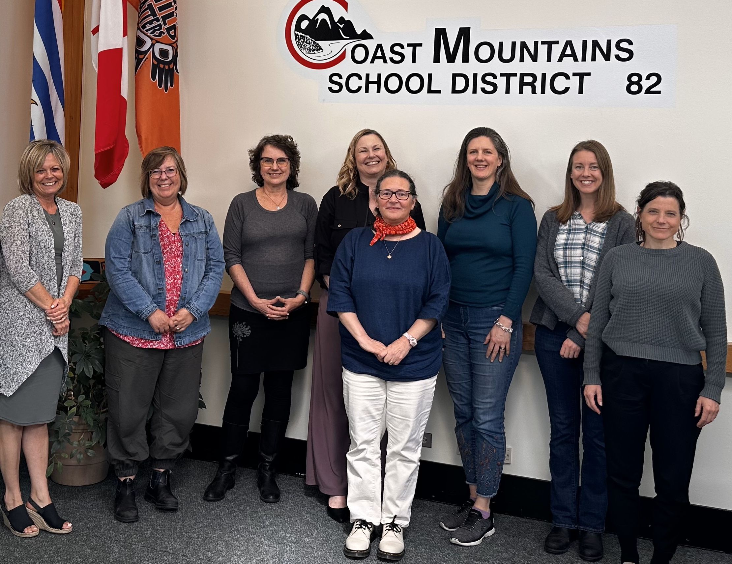
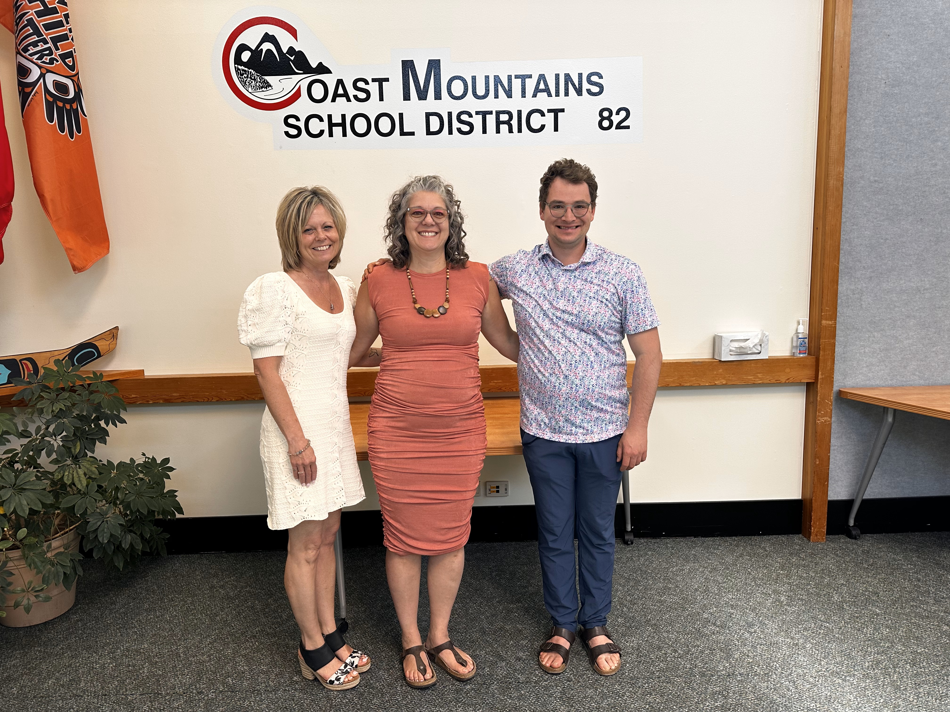


We extend our sincere thanks to the following staff members for their participation in literacy focus groups and related initiatives:
Taryn Armstrong, Catherine Bégin, Sarah Crawley, Jocelynn Drew, Tina Giguere, Amy Graham, Pam Kawinski, Sandy Kenmuir, Geraldine Lawlor, Shylah Marshall, Julia Nieckarz, Lothlan Olsen, Zach Rychlo, Jenelle Van Tunen, and Steve Wallace.
A special thank you goes to those who also contributed directly to the development of this literacy plan and our district’s literacy block frameworks:
Darlene Bragg-Hounsell, Chrysta Carreiro, Hayden Drygas, Laura Gray, Janelle Hittel, Cari Hopkins, Rebecca Howes, Jamie Koch, Tina McDonald, Annette McAlpine, Ana Pires, Cara Purita, Monica Rigoni, Terri Scott, Shelly Striker, and Teresa Wraight.
We also deeply appreciate the guidance and professional learning provided by Dr. Jamie Metsala, Melanie Baerg, and Christine Williams.
We are deeply grateful to the following donors for their generous support of literacy initiatives in CMSD:
17

Slide 18
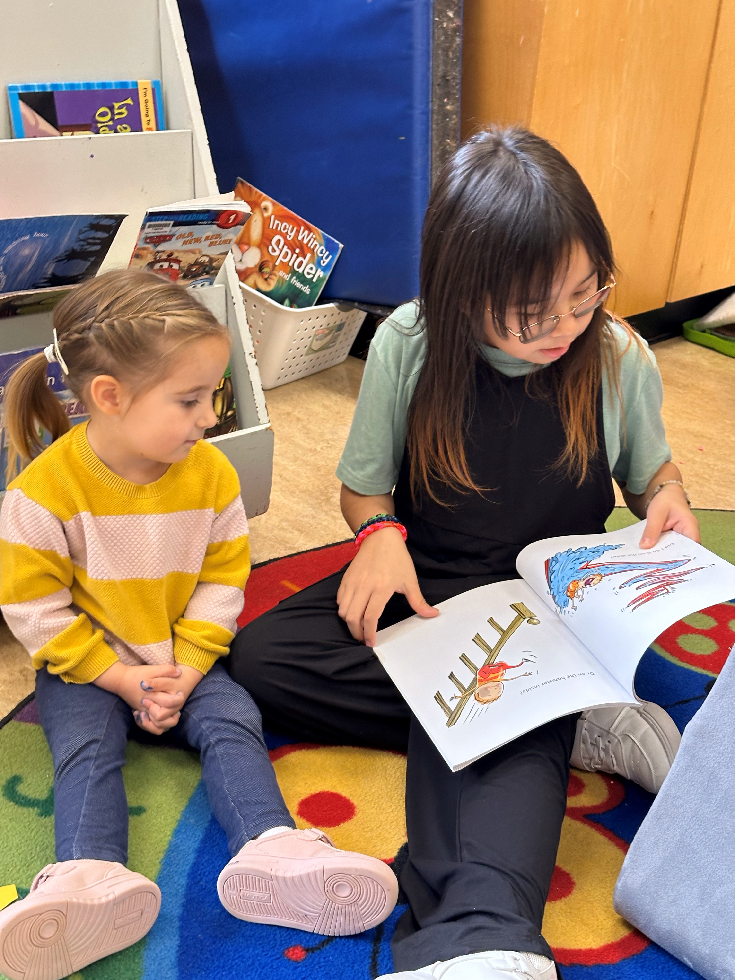
Today a reader, tomorrow a leader
18

