Slide 1

2025-2026 School Growth Plan
School & Location: Kildala Elementary, Kitimat
Principal: Janelle Hittel
Vice Principal: Chrysta Carreiro
Issue Date: September 2025
HIGH QUALITY INSTRUCTION
Theme & A Statement about Learning: The staff, students and community members of Kildala work together to provide a nurturing educational environment that enables all students to meet their academic, social, emotional and physical needs and to empower each individual to reach his/her fullest potential.
Kildala is a school family environment providing a safe, caring and structured place for learning.
Kildala School Snapshot

Slide 2
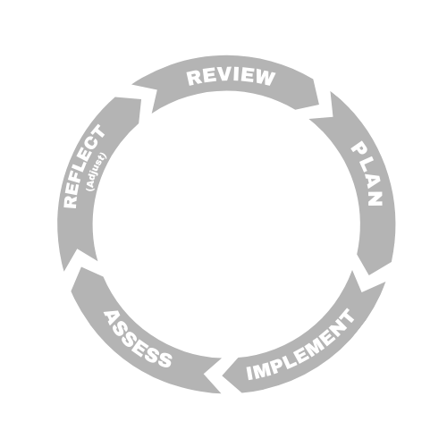



LITERACY
Kildala Elementary School, Kitimat
Goal: We are dedicated to ensuring that students are proficient in foundational literacy skills and increase their abilities, confidence and willingness to engage in reading and writing tasks.
School Actions/Strategy
Literacy Actions here:
Support new teachers with the implementation of UFLI and the use of Acadience as a K-6 Screener.
Examine Acadience data with team and establish a documented plan to support and establish groupings of students into skill ability literacy bin groups to target their missing skills.
Work with all staff in the development of a system of support for all students in yellow and red areas in Acadience.
Emphasize literacy instruction across all subject areas. (Scope and sequence)
Increased access to Tier 2 supports to enhance learning.
Piloting - Know Your Words / Know Your Code.
Implement the use of Empower for Tier 3 intervention.
Provide more choice to enhance student engagement and creativity.
Examine data throughout the year (progress monitoring) and adjust as needed. Collaboration time to help assess SWW.
Objectives
We use our literacy data to drive instruction and adjust as needed for ALL students.
We implement competency-based assessment and reporting.
We offer the opportunity for ALL students to demonstrate learning in a variety of ways.
School Data & Evidence
Literacy Measures here:
FSA Grade 4
School-Wide Write
Acadience Data
Student Self Assessments
Individual Education Plans (IEPs) (as applicable)
Multi-Tiered System Support (MTSS)
Report Card Results
District Data & Evidence
FSA 4 (Reading / Writing)
Acadience Data
School-Wide Write
K Screener

Slide 3

NUMERACY
NUMERACY
Kildala Elementary School, Kitimat
Goal We are dedicated to ensuring that students become proficient in numeracy skills that allow them to create, apply and conceptualize mathematics in real world situations from Early Learning Years (pre-Kindergarten) through to Grade 6.
Objective
Common word problem vocab language
reinforcing basic skills through games
connecting it to real life situations
focusing on a more growth mindset towards math concepts
School Actions/Strategy
Numeracy Actions here:
Collect and analyze data (e.g., standardized assessments, report card marks, classroom-based assessments).
Encourage collaborative planning. Develop common language and resources. Scope and Sequence, Daily School Wide Math Minute, Monthly Math afternoons, Family Math Night
Promote balanced math instruction (fluency, conceptual understanding, and application).
Embed formative assessment practices.
Use assessment data to identify students needing additional support.
Share successes and challenges across staff to build collective efficacy.
Use common resources (Mindful Math, primary; Shelley Gray, Mathletics, Sumdog, intermediate) Check out Journey Math and Facts on Fire programs
School Data & Evidence
Numerary Measures here:
Report Card Results
Grade level district Numeracy Results.
Anecdotal observations and ongoing conversations with teaching staff, learner support teams.
Other relevant data points both local and provincial such as FSA.
District Data & Evidence
Grade 4 FSA
K–6 Report Card Data
District Numeracy Assessment

Slide 4

INCLUSION
Kildala Elementary School, Kitimat
Goal We will honour, celebrate and respect culture, diversity and inclusion to foster a sense of belonging to ensure all students thrive and feel welcome. Equity and inclusion are foundational to learning and leading, and are critical to success, well-being and fulfillment.
School Actions/Strategy
Inclusion Actions here:
Attendance: Monitor and track student attendance in MyEd closely and implement early, proactive interventions – such as regular check-ins, culturally responsive outreach, and collaborative problem-solving with students, families, and Indigenous Support Workers and Indigenous Education Coordinators (where applicable), to reduce chronic absenteeism and support student engagement.
Embed anti-racism and cultural responsiveness in year plans, lesson plans and school activities across all grades. (School Wide Collaborative Projects and Events, Friendship Club)
Review and revise school procedures, codes of conduct, and restorative practices to identify and address inequities.
Develop stronger leadership skills in the intermediate students, to foster effective peer relations (Grade 5/6 Leadership Club)
Objectives
Enhance the achievement of all learners with an emphasis on Indigenous learners, children and youth in care, and students with designations.
Implement ongoing anti-racism education for students and staff to build awareness, challenge biases, and dismantle systemic racism within the school environment.
School Data & Evidence
Inclusion Measures here:
Report Cards
Tracking Attendance (MyEd)
LEA Deliverables
EdPlan Insight
Numeracy Assessments
Literacy Assessments
District Data & Evidence
Aboriginal How Are We Doing Report
Local Education Agreement (LEA)
Student Learning Survey Grade 4
FSAs
Student Voice

Slide 5

MENTAL HEALTH & WELL-BEING
Kildala Elementary School, Kitimat
Goal Students will increase their mental health well-being by developing a growth mindset, resiliency, self-regulation, and citizenship skills while exploring personal passions and interests that will create their overall sense of self and belonging within their community.
Objectives
Embed mental health and wellness strategies in classroom instruction
Create a peer support network
Involve students in planning and evaluating well-being initiatives
In school to parent communications offer resources to help families support their children’s mental health.
School Actions/Strategy
Mental Health & Well-Being Actions here:
Use collaboration time and assemblies to target core competencies and mental health through Open Parachute and stories
We will build a sense of place because how we come to know places such as homes, communities, towns and local environments we inhabit impacts our well being
Increased focus on land-based learning
Collaboration with Haisla Community School and partners
Intermediate Leadership Club
Grade 6 Conference
School Data & Evidence
Mental Health & Well Being Measures here:
School results to the relevant Development Index.
Student Learning Survey
Tracking Attendance (MyEd)
District Data & Evidence
Student Learning Survey Grade 4
EDI (Early Years)

